Slide 1

First Project for Machine Learning Boot Camp
Topic: EDA & Data Analysis.
Renzo Torrecuso
19. 02.2024

Slide 2

Scenario:
I am an employee of a company which offers Data Analysis for clients dealing with complex problems.
Client:
Zachary Brooks.
He is a Seller.
- Invests in historical houses
in best neighborhoods.
- High profits,
best timing withing one year,
may or may not renovate.

Slide 3
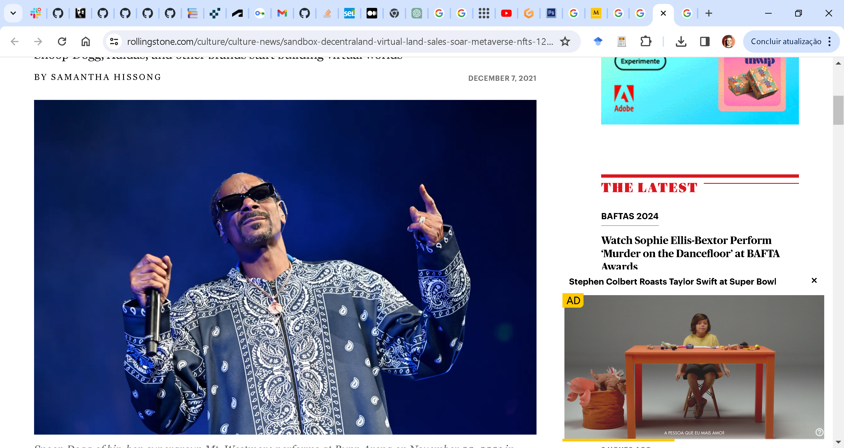
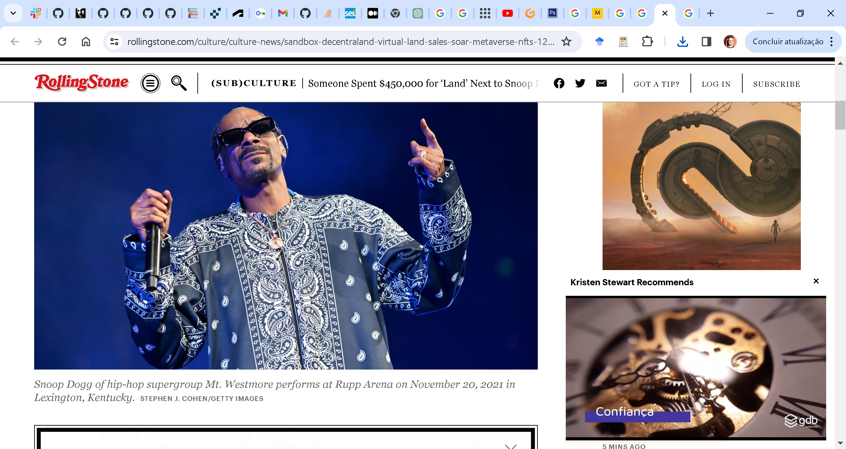
On the 3rd of December 2020, someone paid US$ 450000 for a house right beside Snoop Dog´s one.
... neither of the houses were made of anything else than zeros and ones....
... and status, a lot of status.
Status is a useful tool to aggregate value to a product
HIPOTHESYS
1. A ‘good’ neighbourhood has its house prices
impacted by high status outlier in price houses.
Not necessarily better than less expensive
ones in the neighbourhood.
2. The higher profits may be in the surroundings
of the outliers, with houses on even better
conditions by half the price.
3. If Mr Brooks thinks the best timing is one year,
maybe instead of renovating, it is better to find a
house in good condition and close to a price outlier..

Slide 4
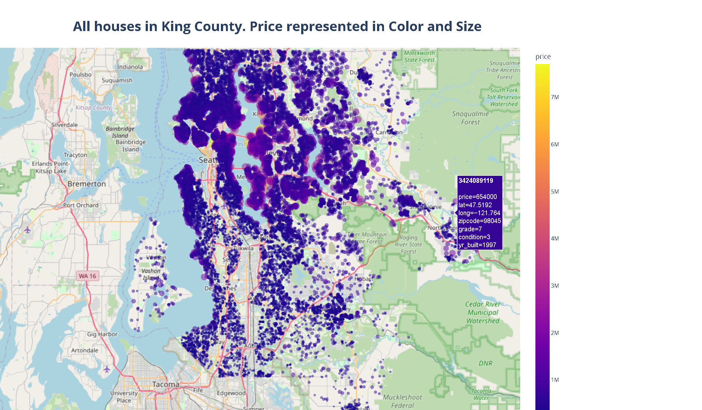

Slide 5
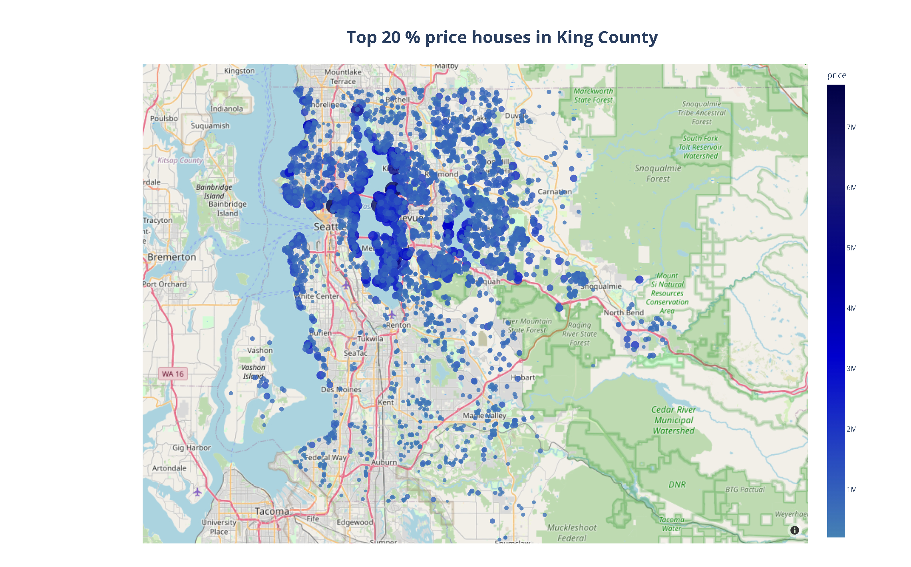
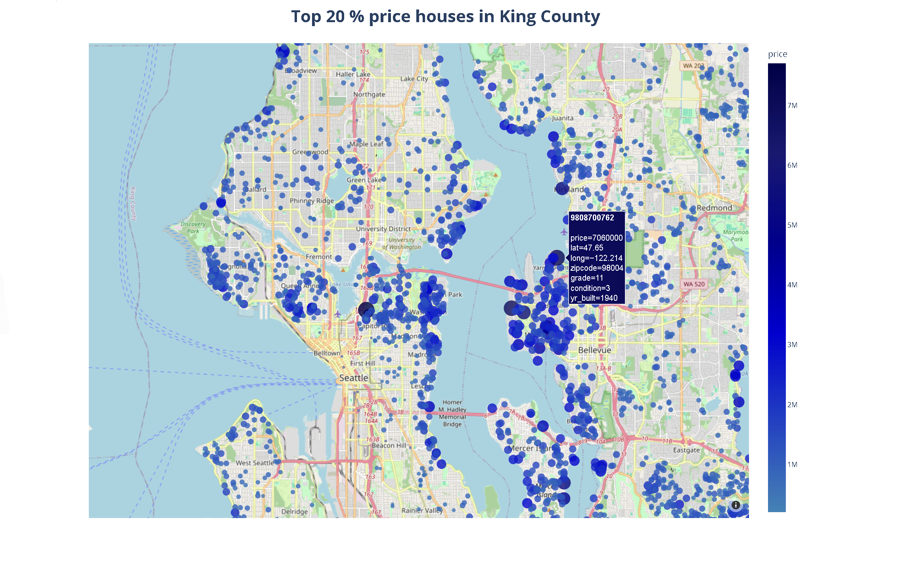
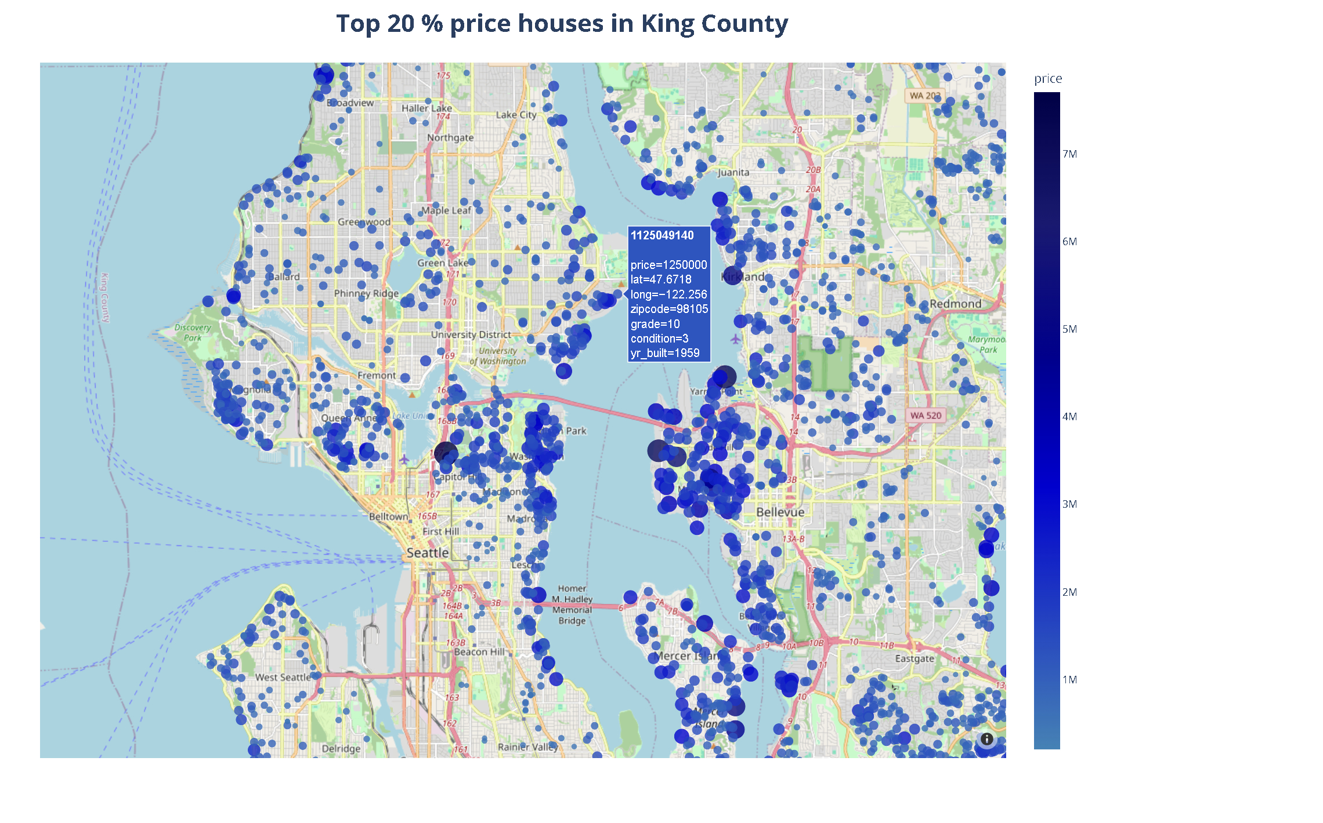

Slide 6
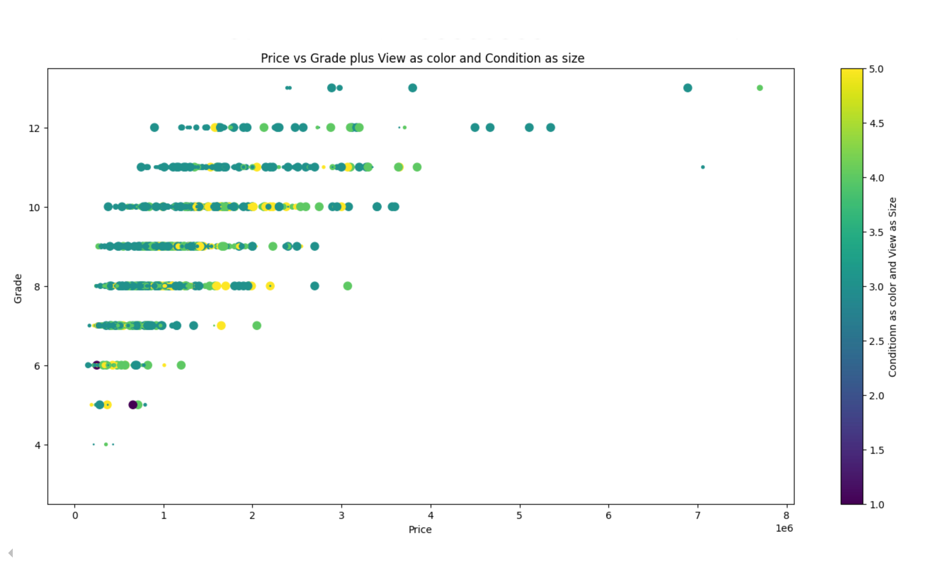

Slide 7
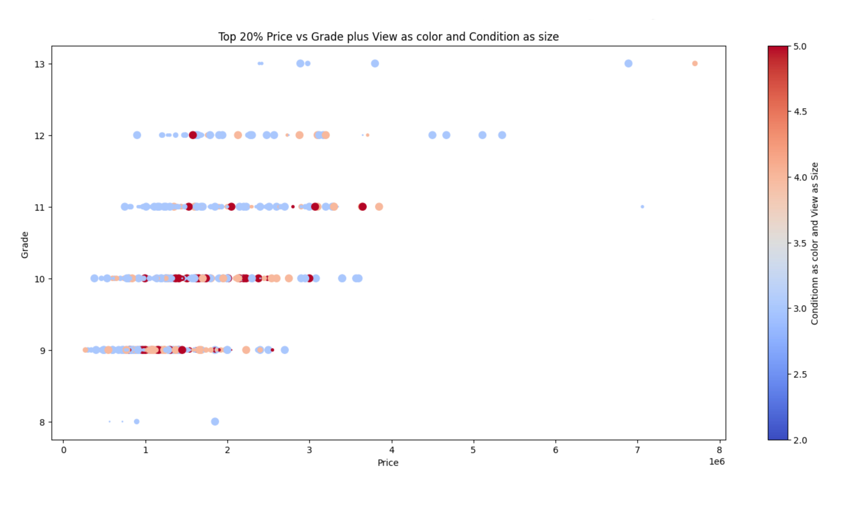

Slide 8
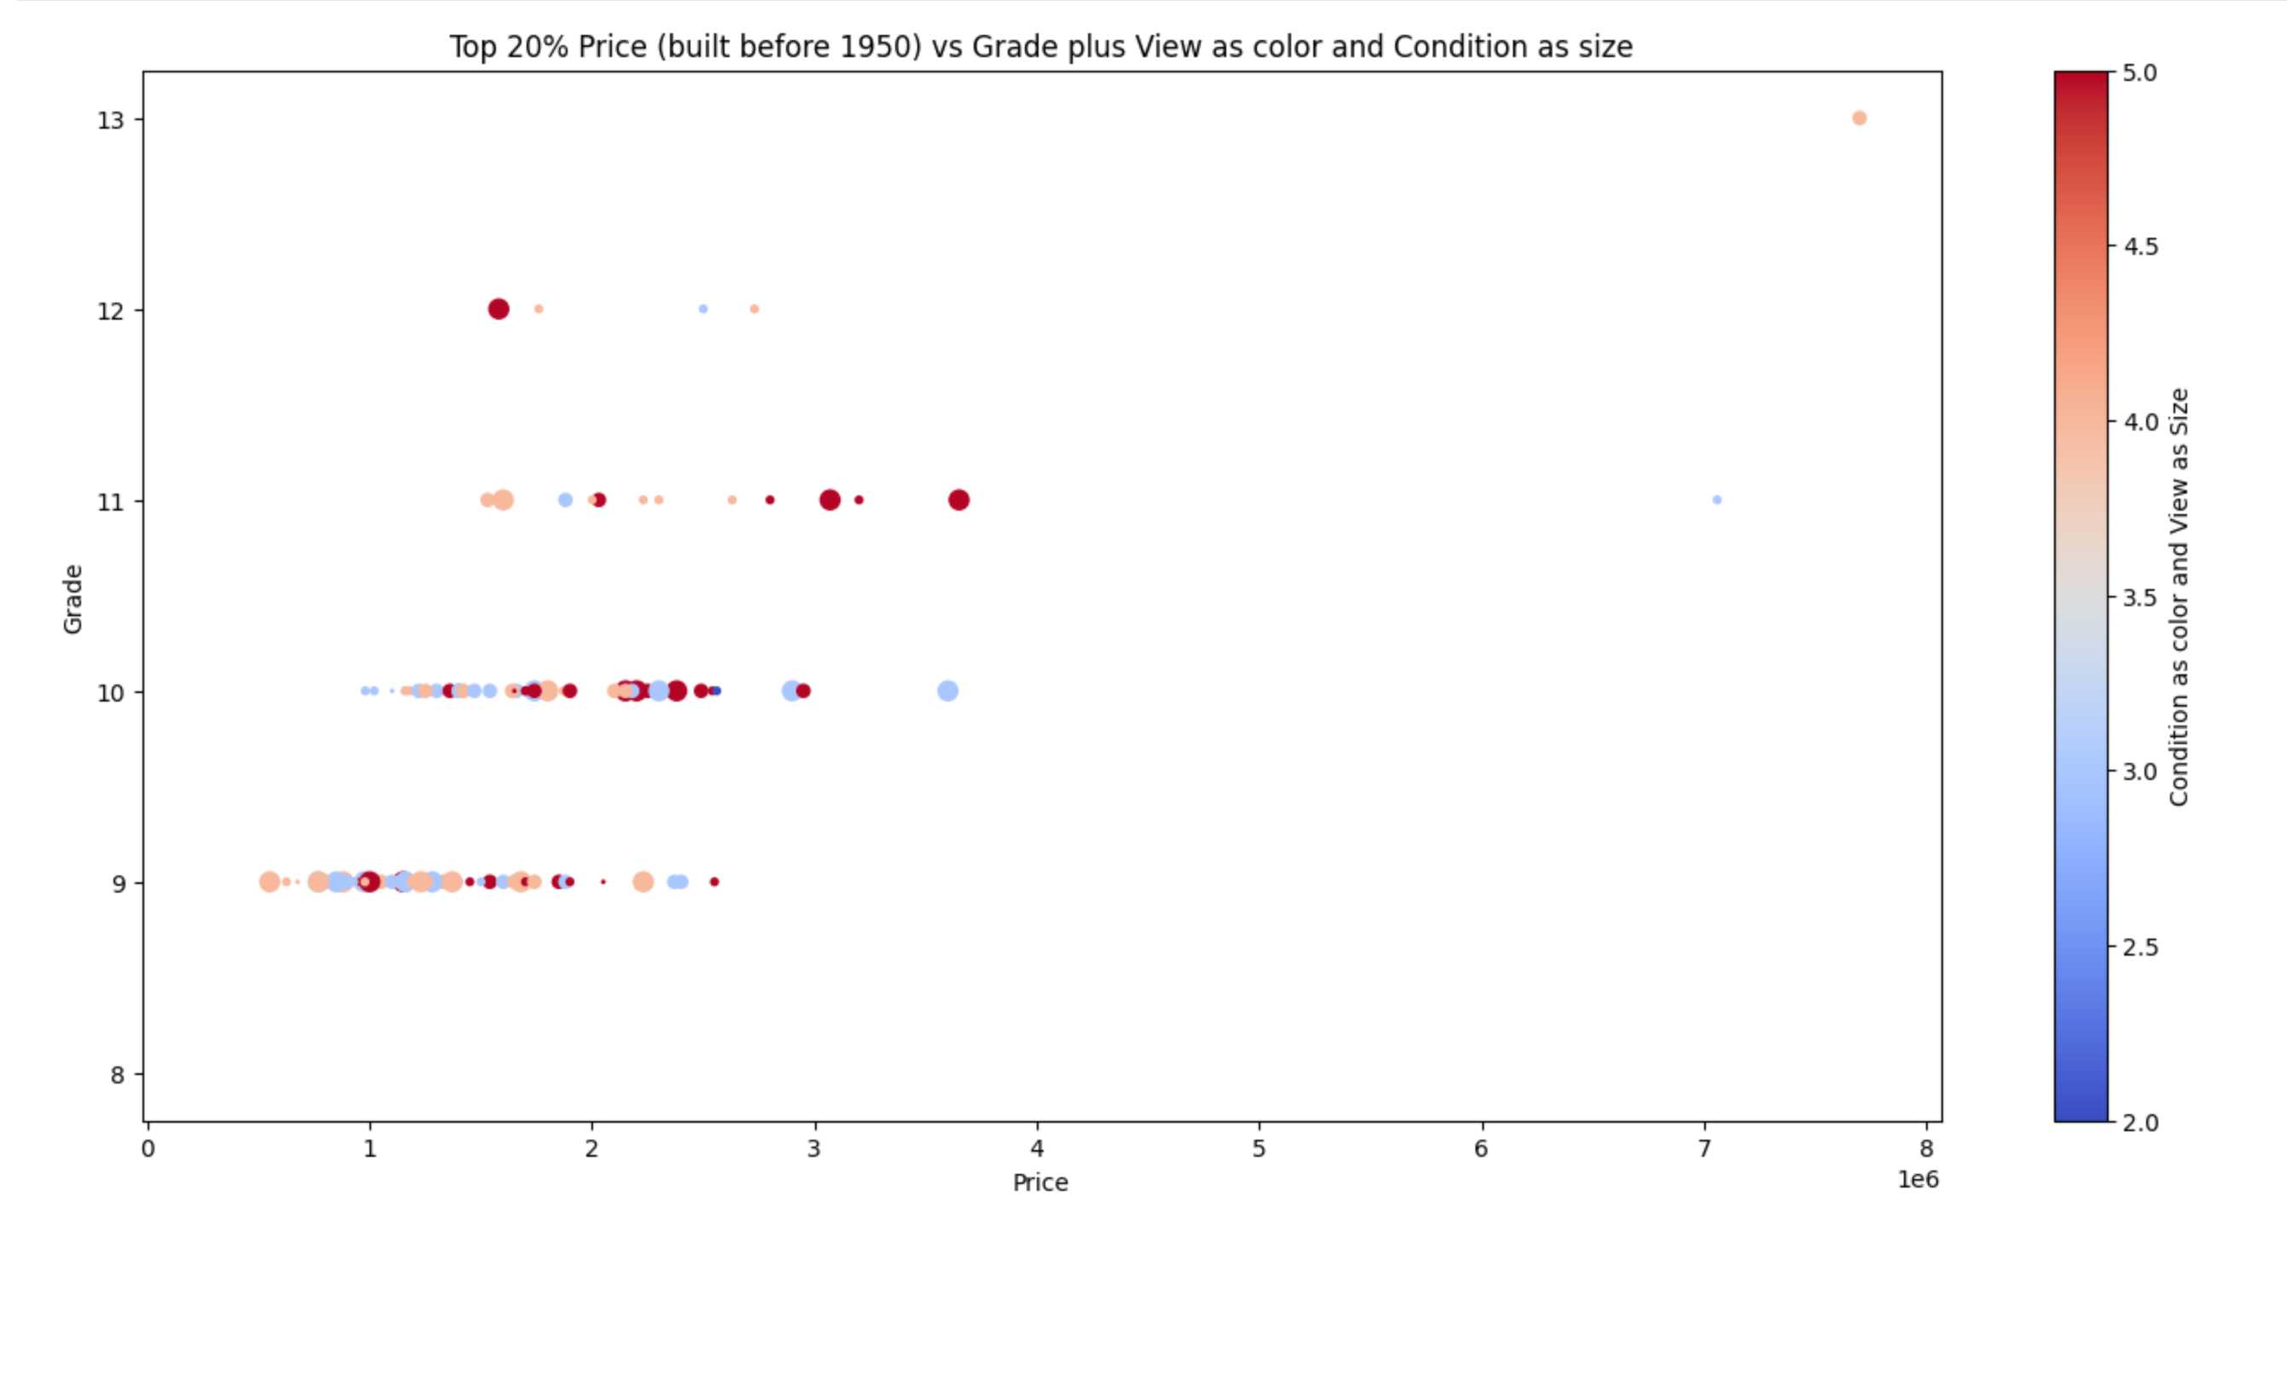

Slide 9
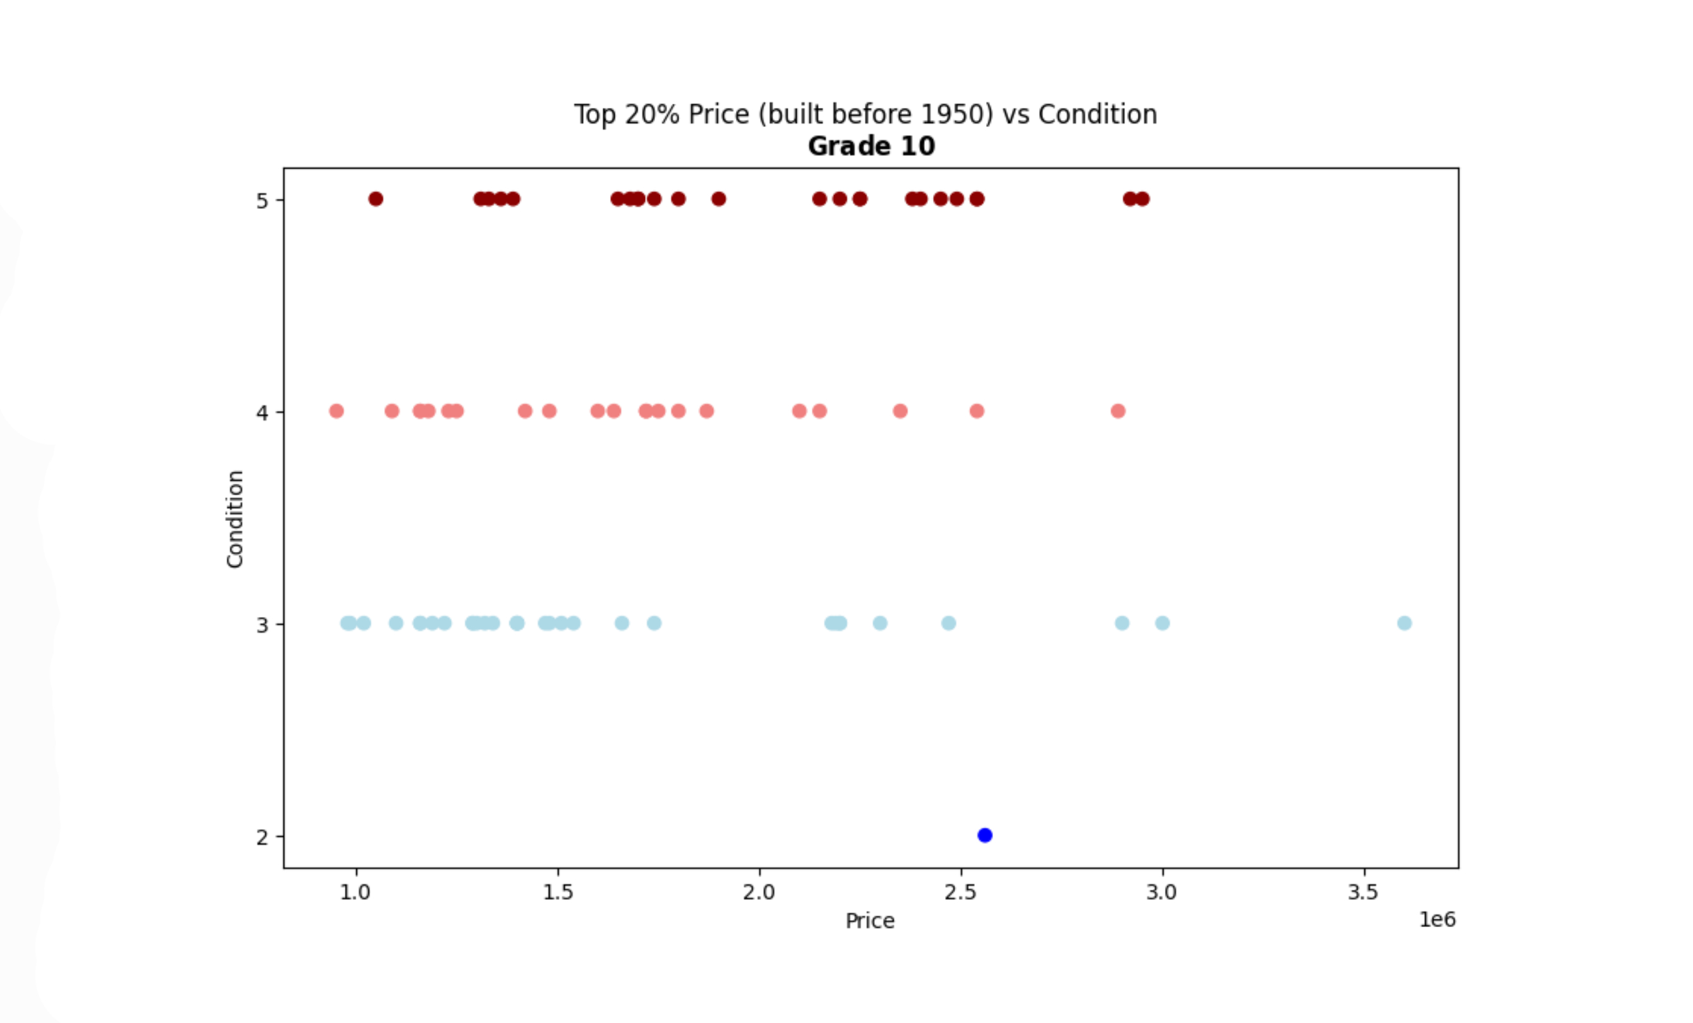

Slide 10
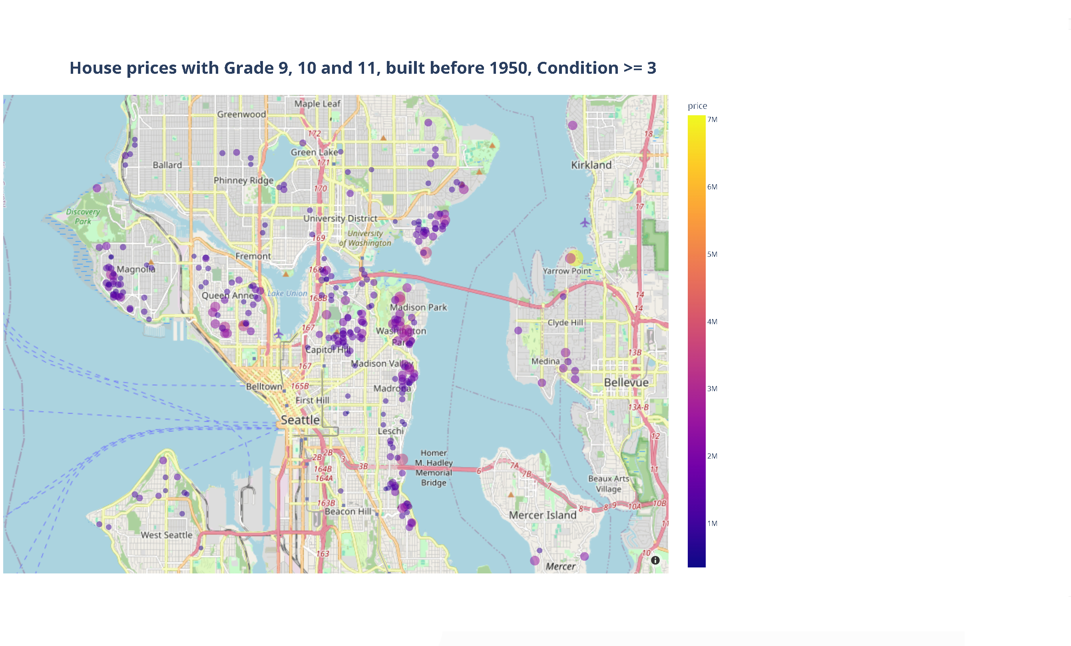

Slide 11
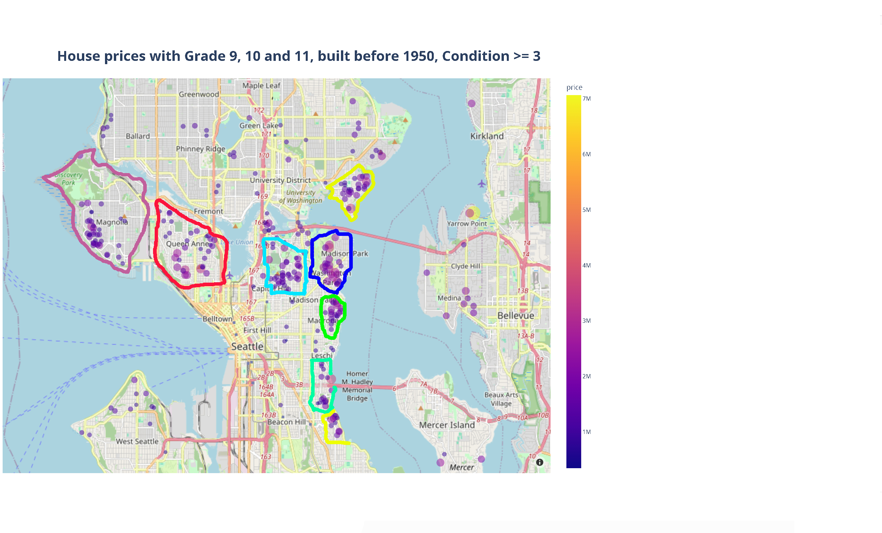

Magnolia
Queen Anne
Webster Point
Homer M. Bridge
Capitol Hill
...
Zack wants to find the historical houses that will help him make money

Slide 12
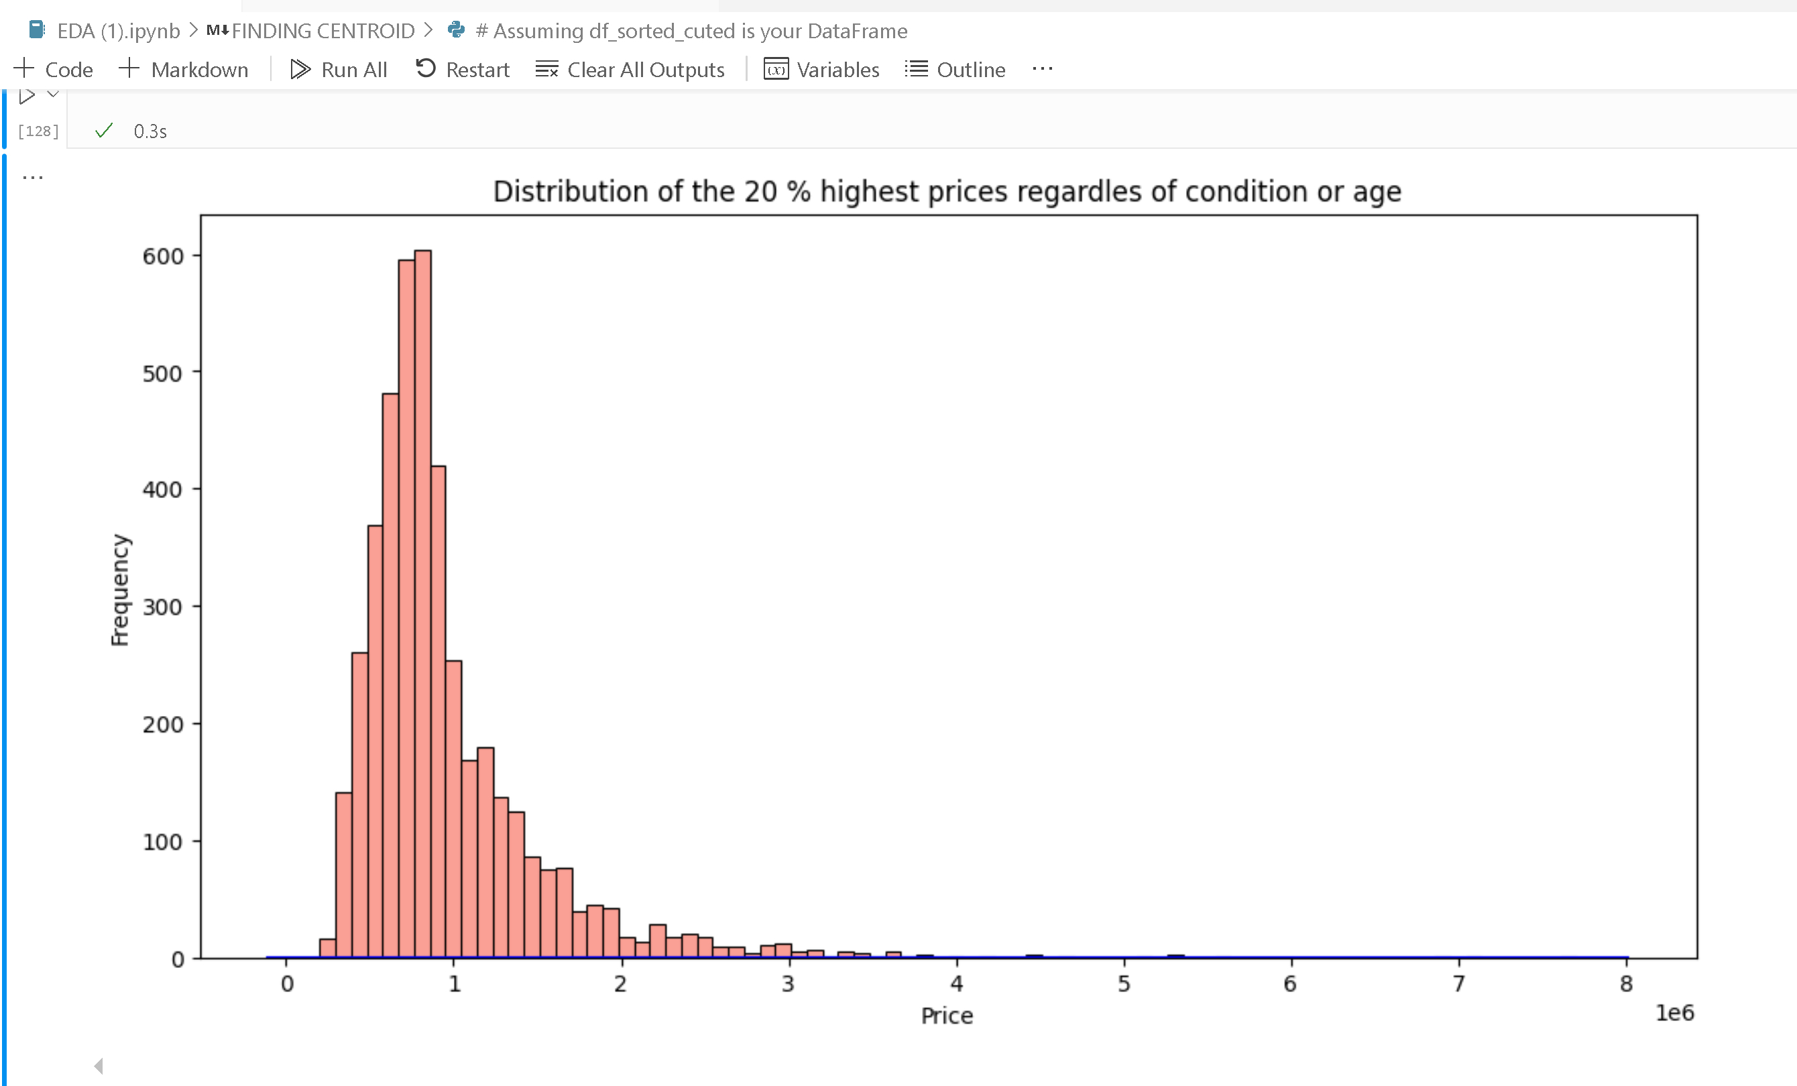
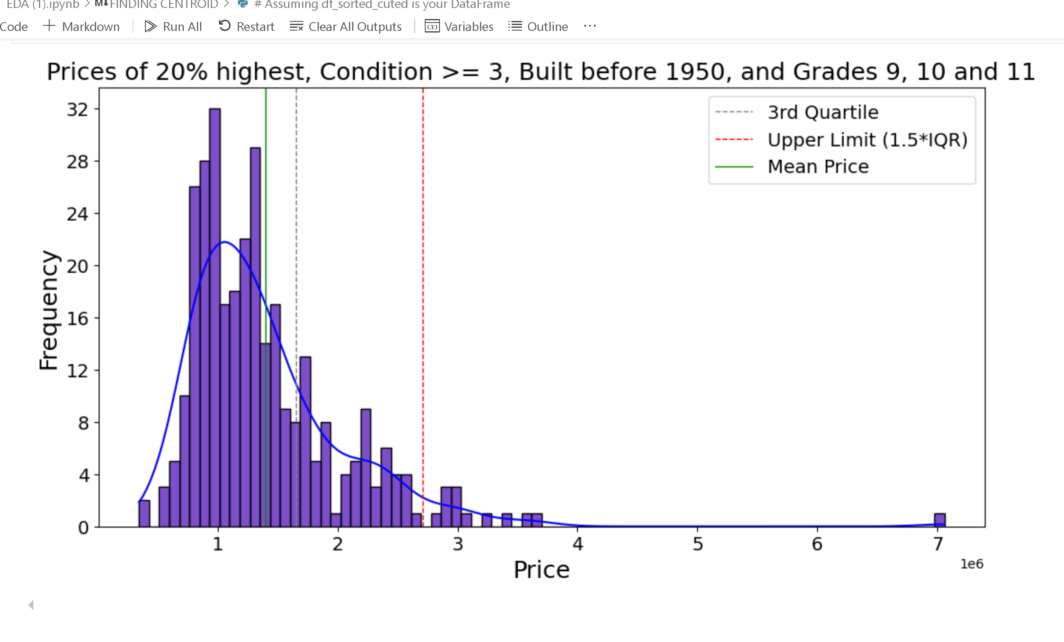

Slide 13
How do I define and find a centroid?
5. Double for to calculate distance between all above & below.
for each house_below :
for each house_above:
Calculate distance between house_below and house_above
distance = haversine(house_below['lat’],
house_below['long’],
house_above['lat’],
house_above['long'])
Create dictionary with house_below ID, house_above ID,
& distance
{ 'house_below_id': house_below['sales_id'],
'house_above_id': house_above['sales_id'],
'distance_km': distance}
6. Convert the distances list to a DataFrame
distances_df = Convert distances to DataFrame
A centroid here is defined as a house ABOVE 2.75M surrounded by a group of houses BELOW 2.75M which are
closer to this ABOVE 2.75M than to any other house ABOVE 2.75M
1 Define variables for filtering criteria
grade= [9, 10, 11] , year_built = 1950, condition => 3
price_threshold = 2.75M
2 Initialize empty lists for two categories of houses
houses_above_price = [] houses_below_price = []
3 Iterate through each house in filtered df:
if house['price'] > price_threshold:
Add house to houses_above_price
else:
Add house to houses_below_price
4 Define a function to calculate distance
between two points:
Function haversine(lat & long) returns distance in km.

Slide 14
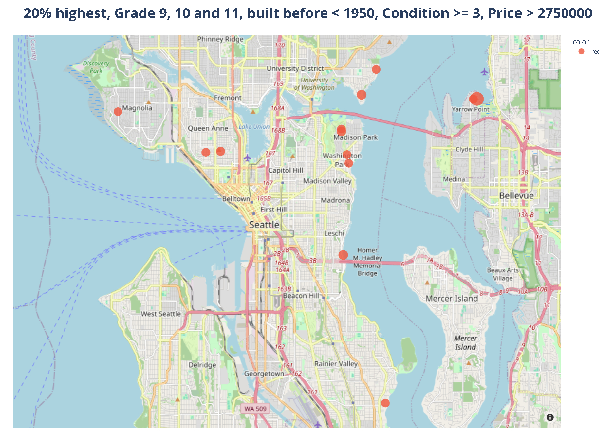

Slide 15
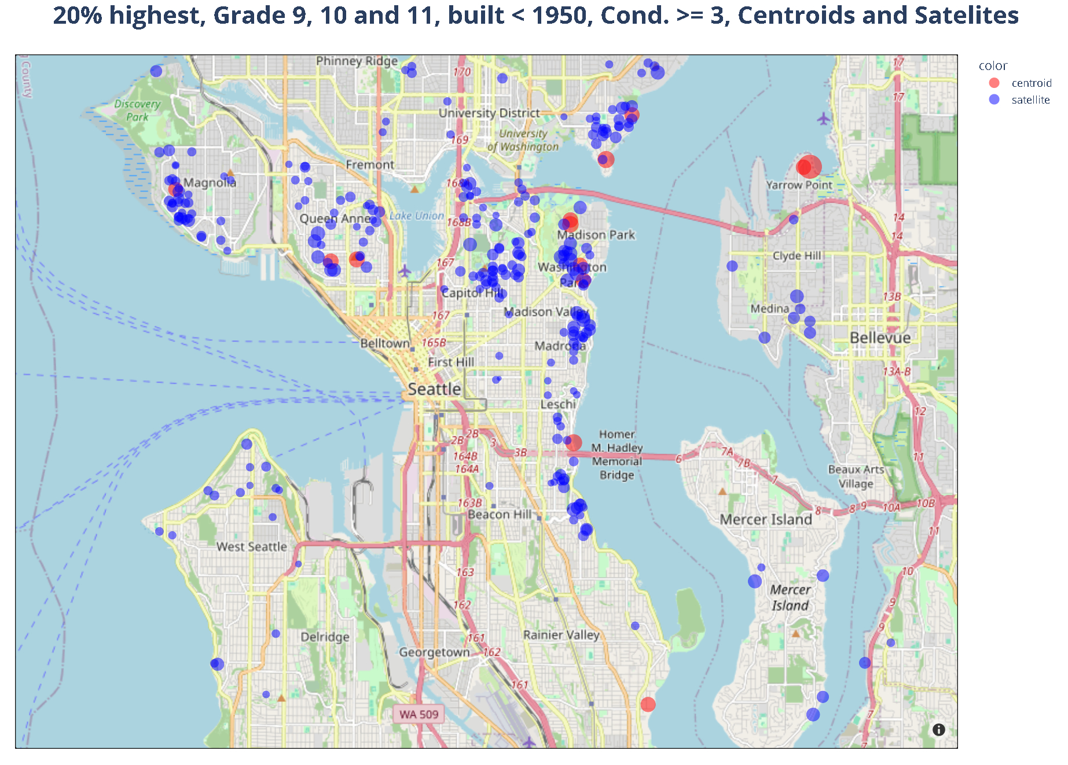

Slide 16
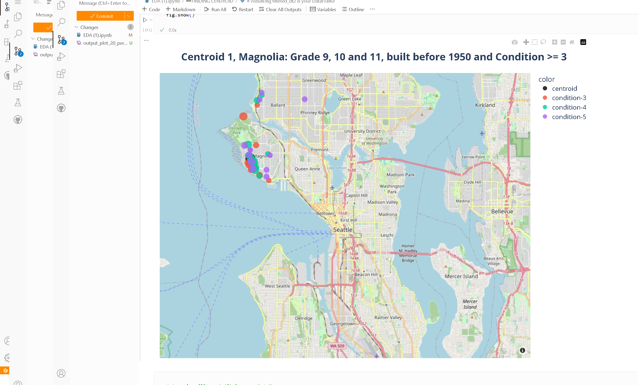
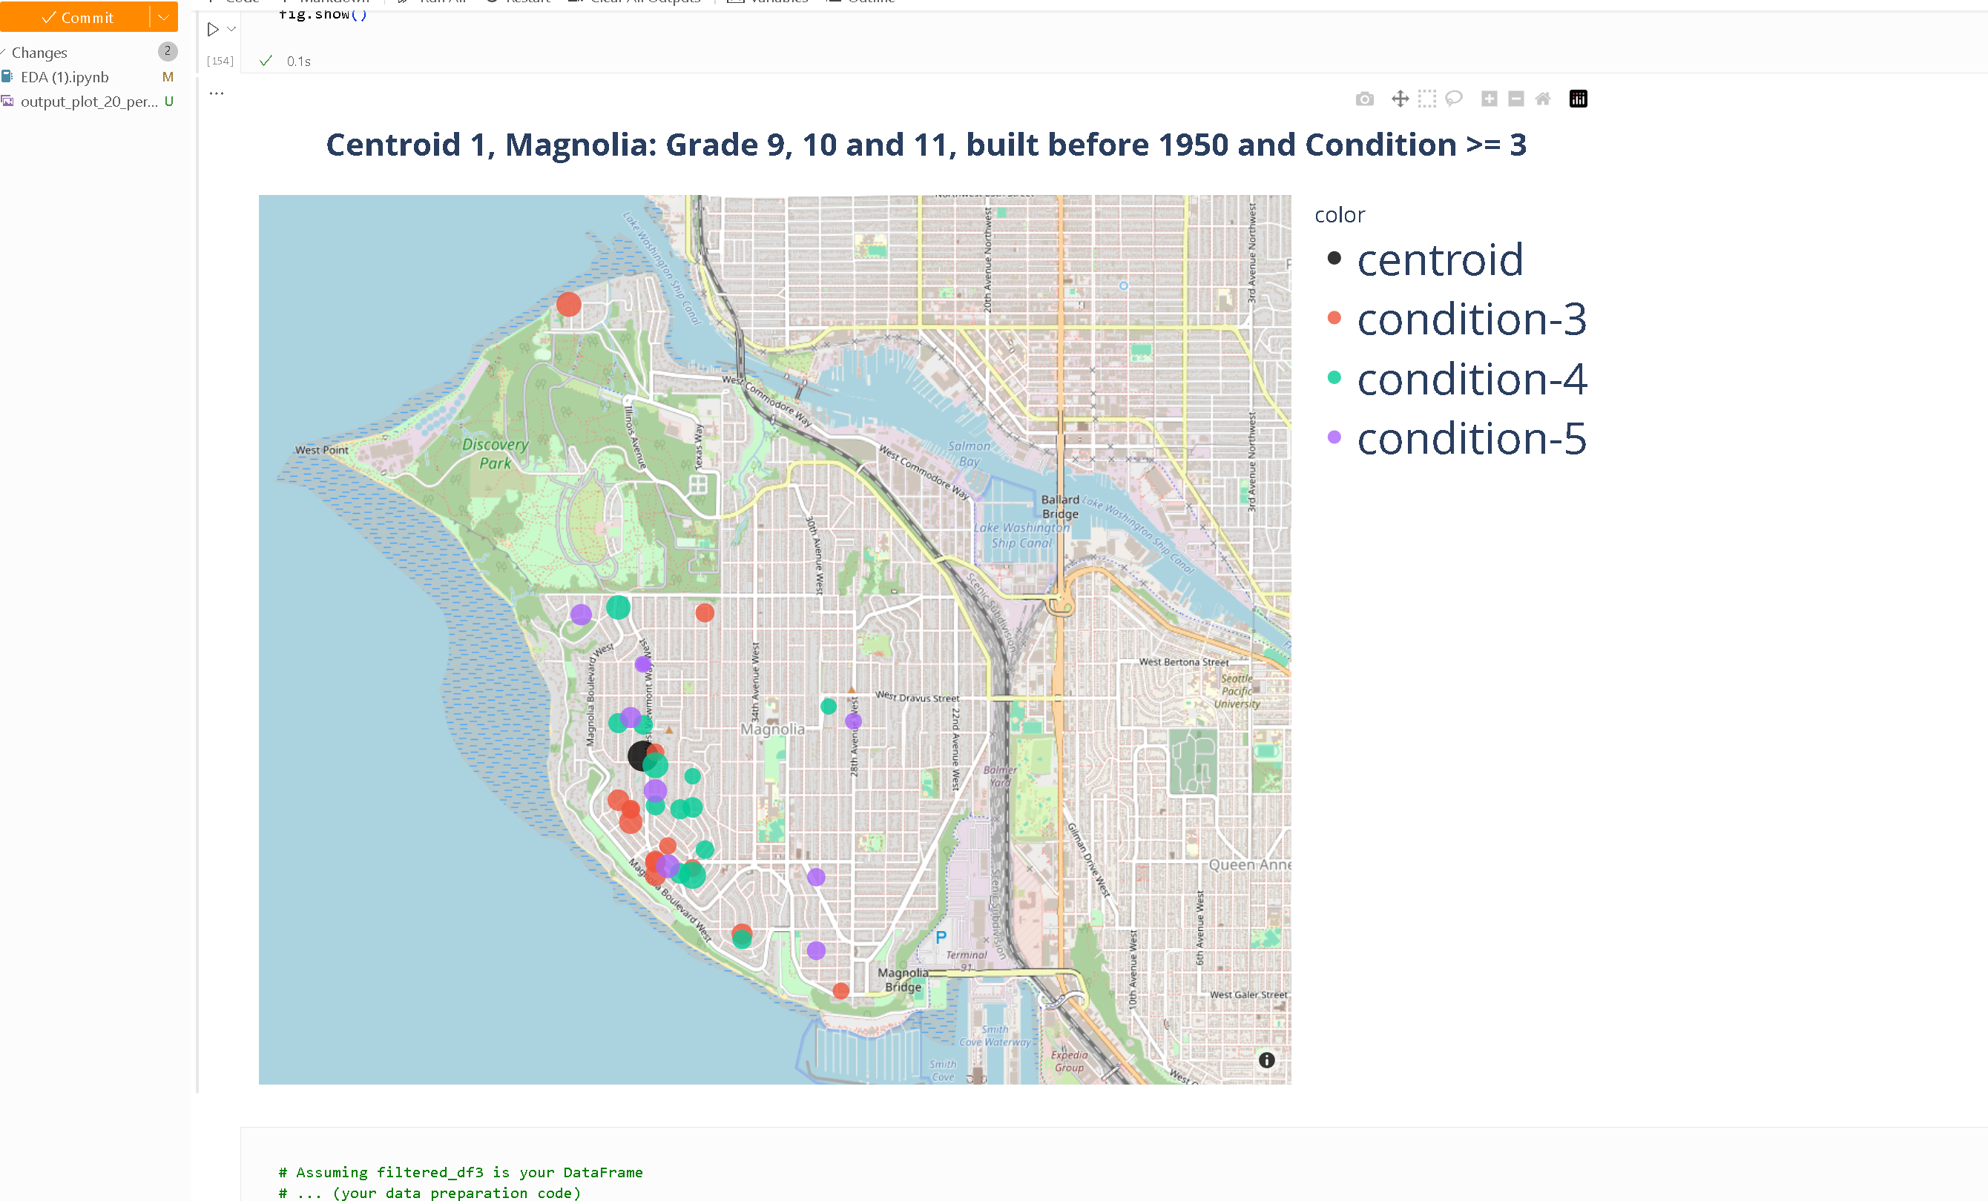

Slide 17
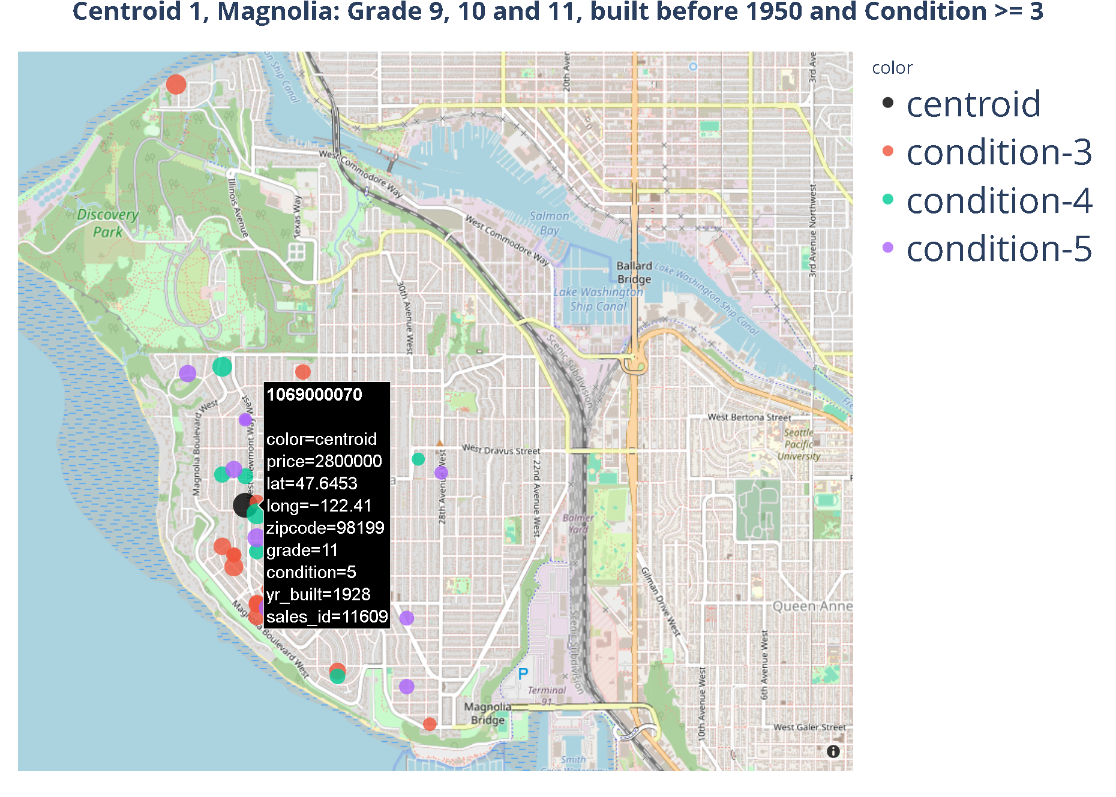

Slide 18
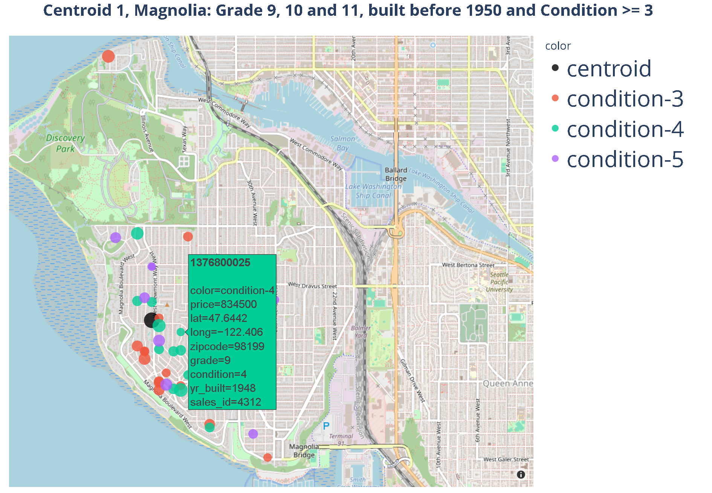

Slide 19
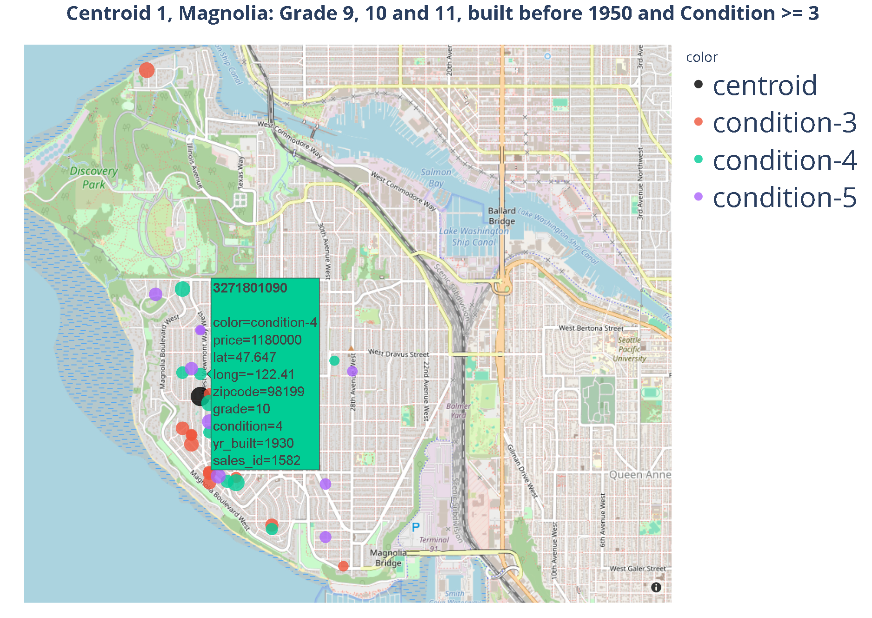

Slide 20
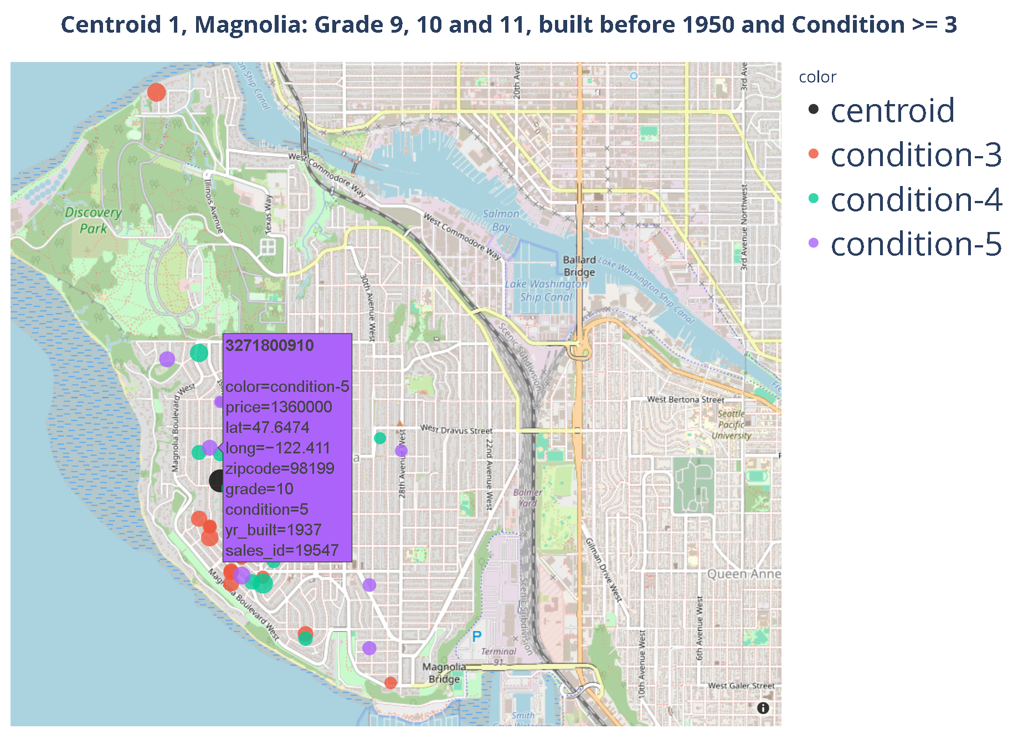
Objective comparison
Bedrooms: 5
Sqft Living:
4590
Price:
2.8 M
Bedrooms: 4
Sqft Living:
4270
Price:
1.36 M

Slide 21
Objective comparison
Bedrooms: 5
Sqft Living:
4590
Price:
2.8 M
Bedrooms: 4
Sqft Living:
4270
Price:
1.36 M

Slide 22
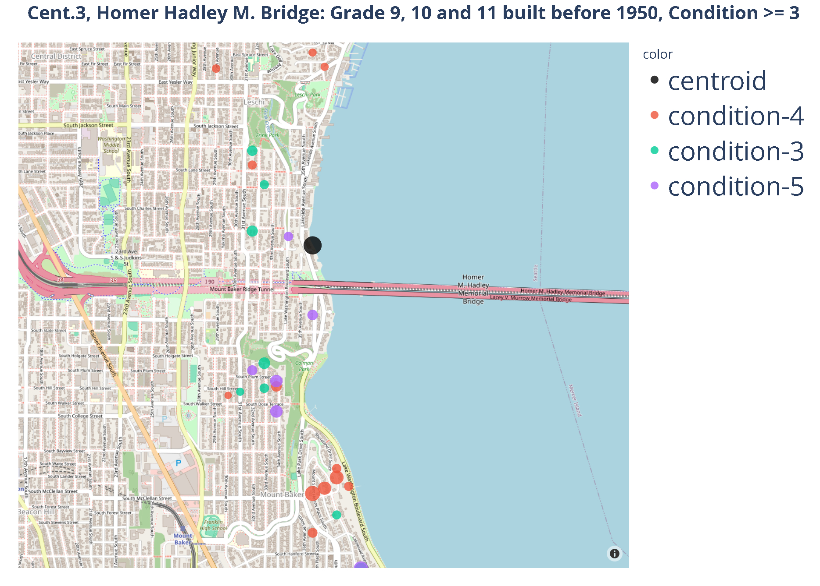

Slide 23
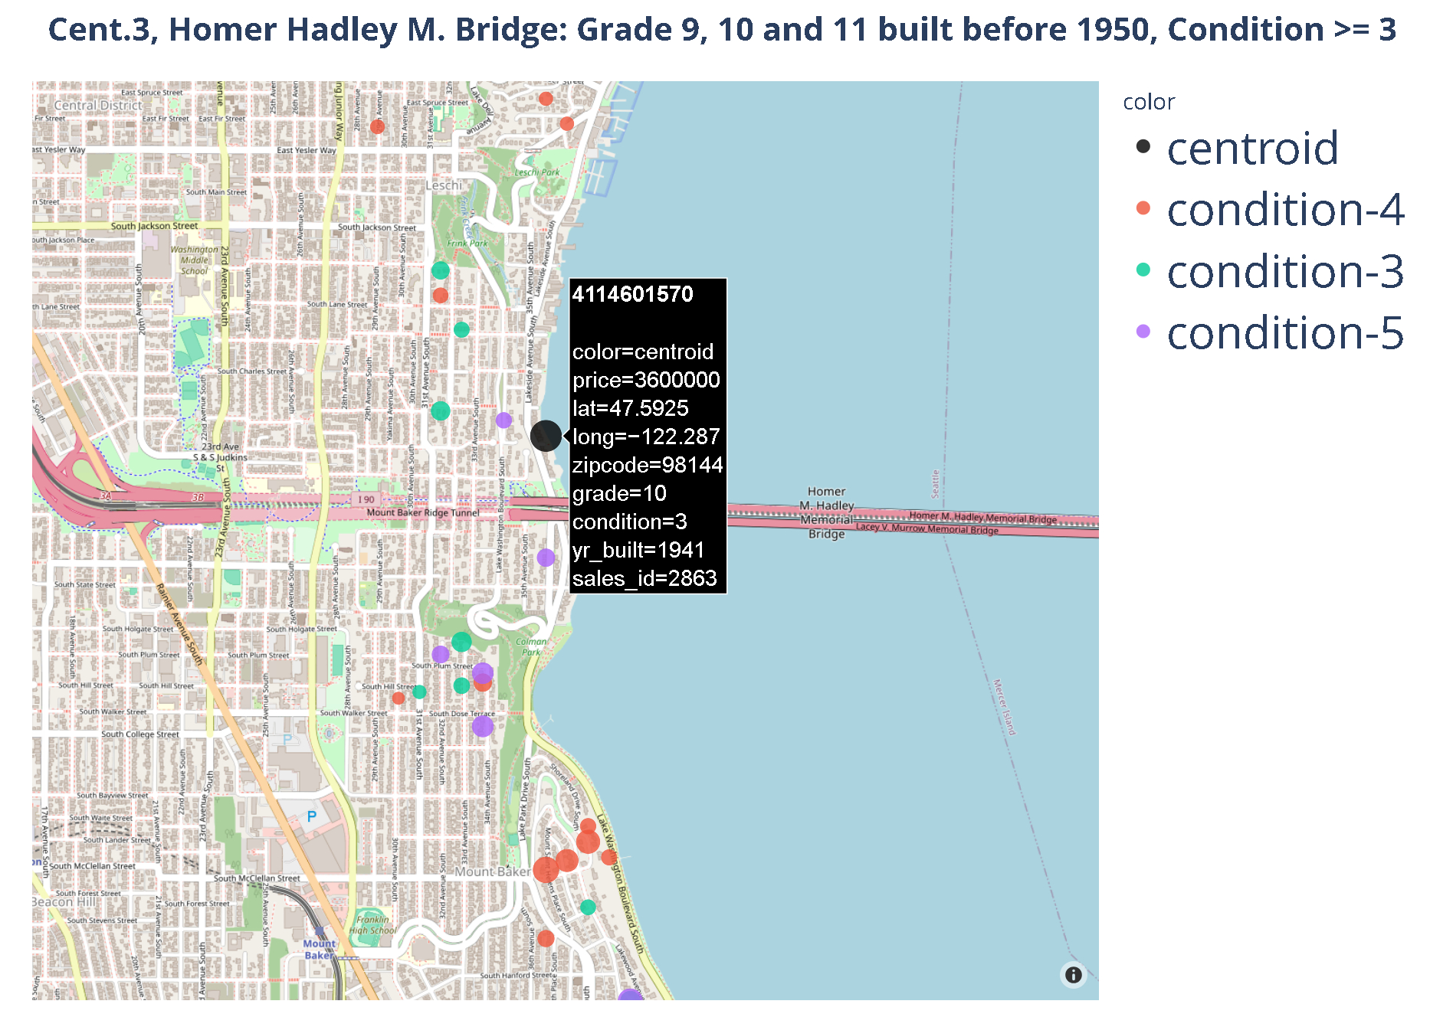

Slide 24
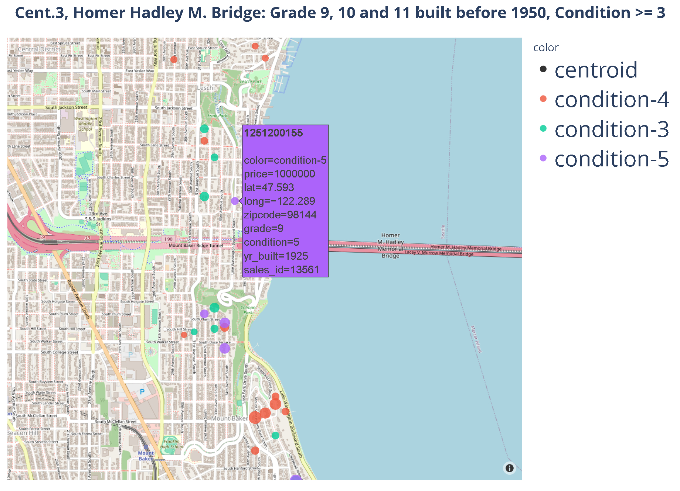

Slide 26
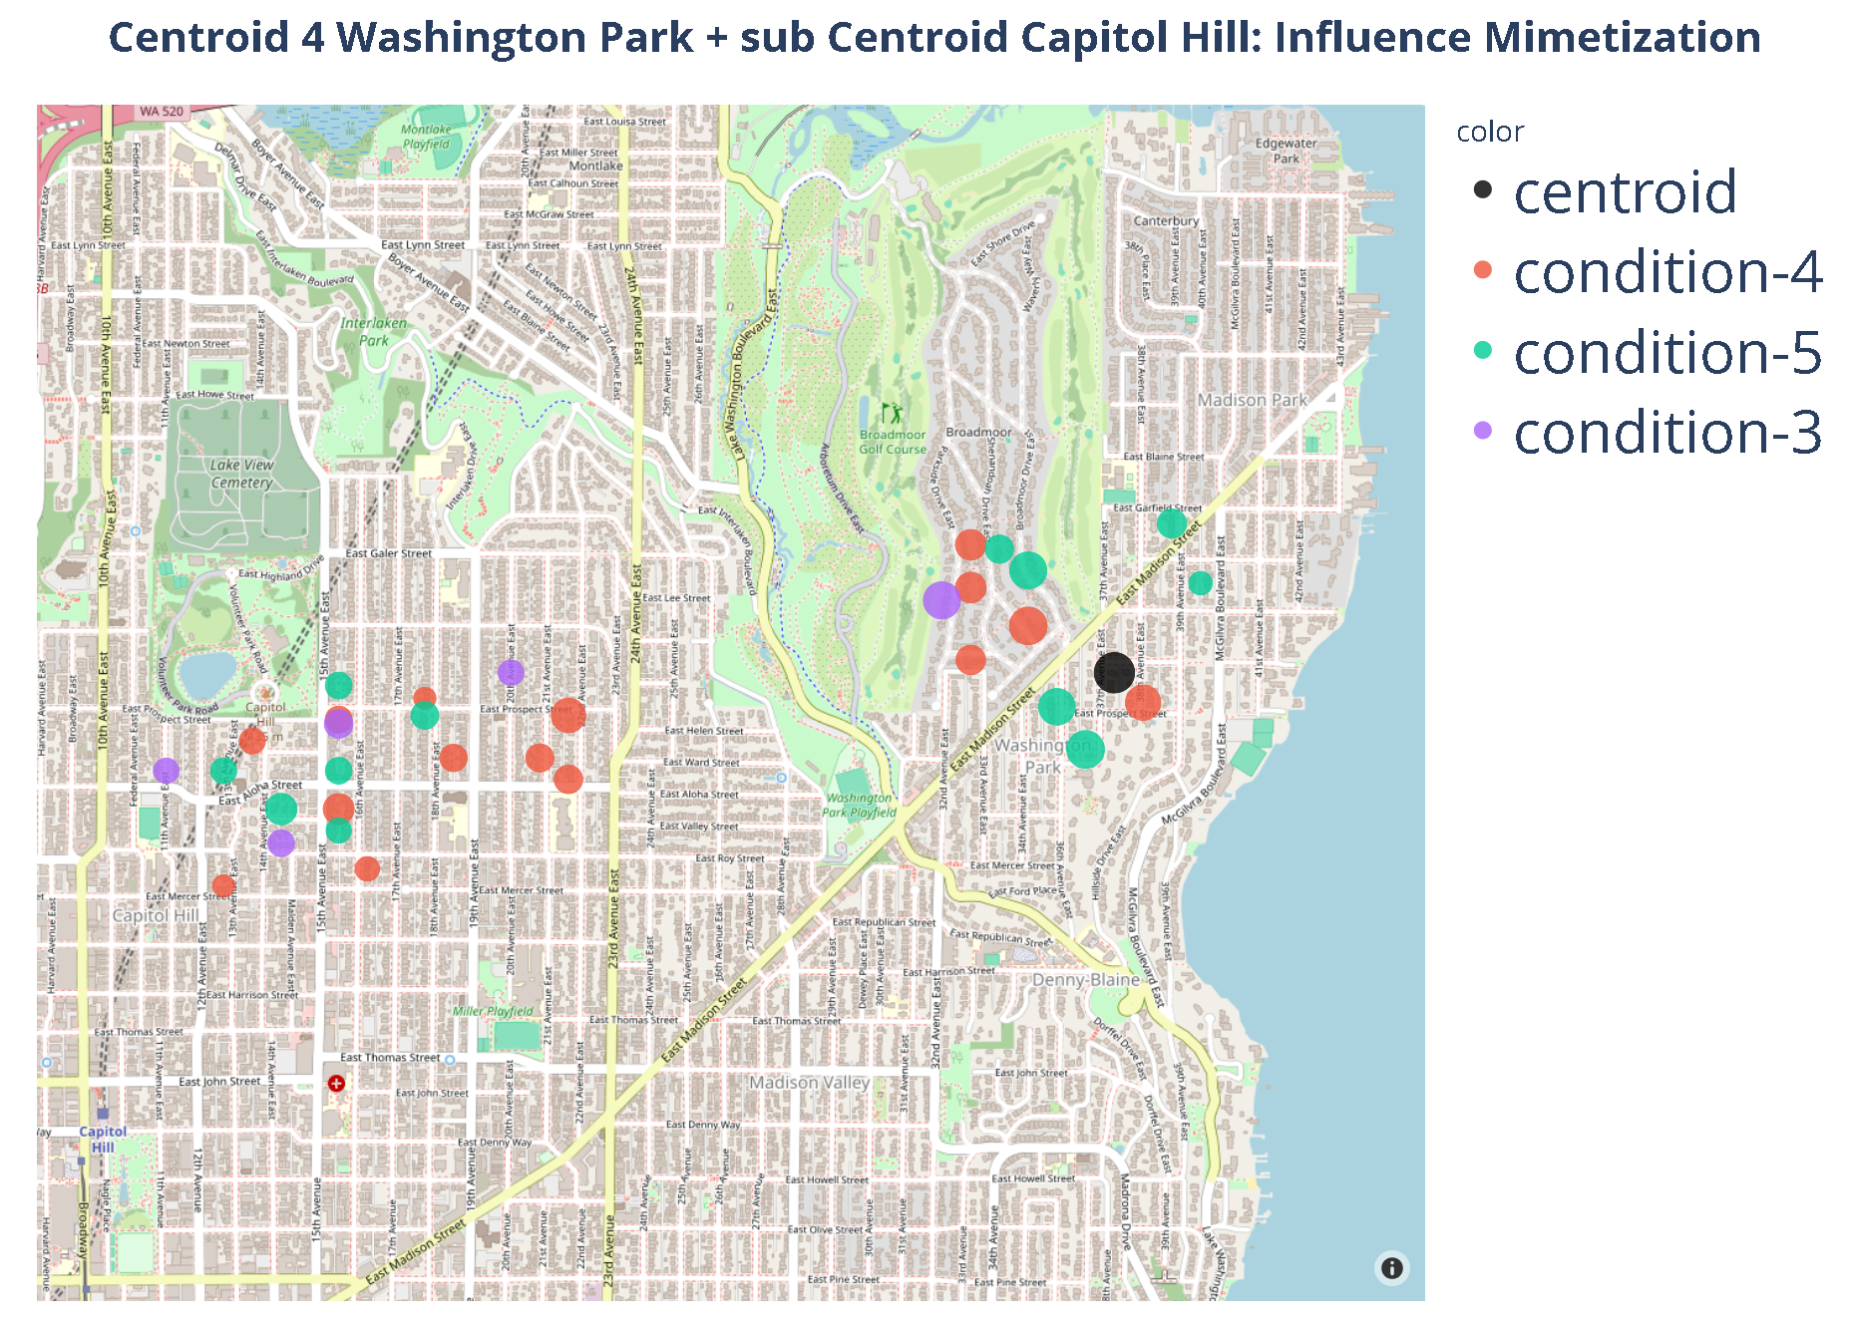

Slide 27
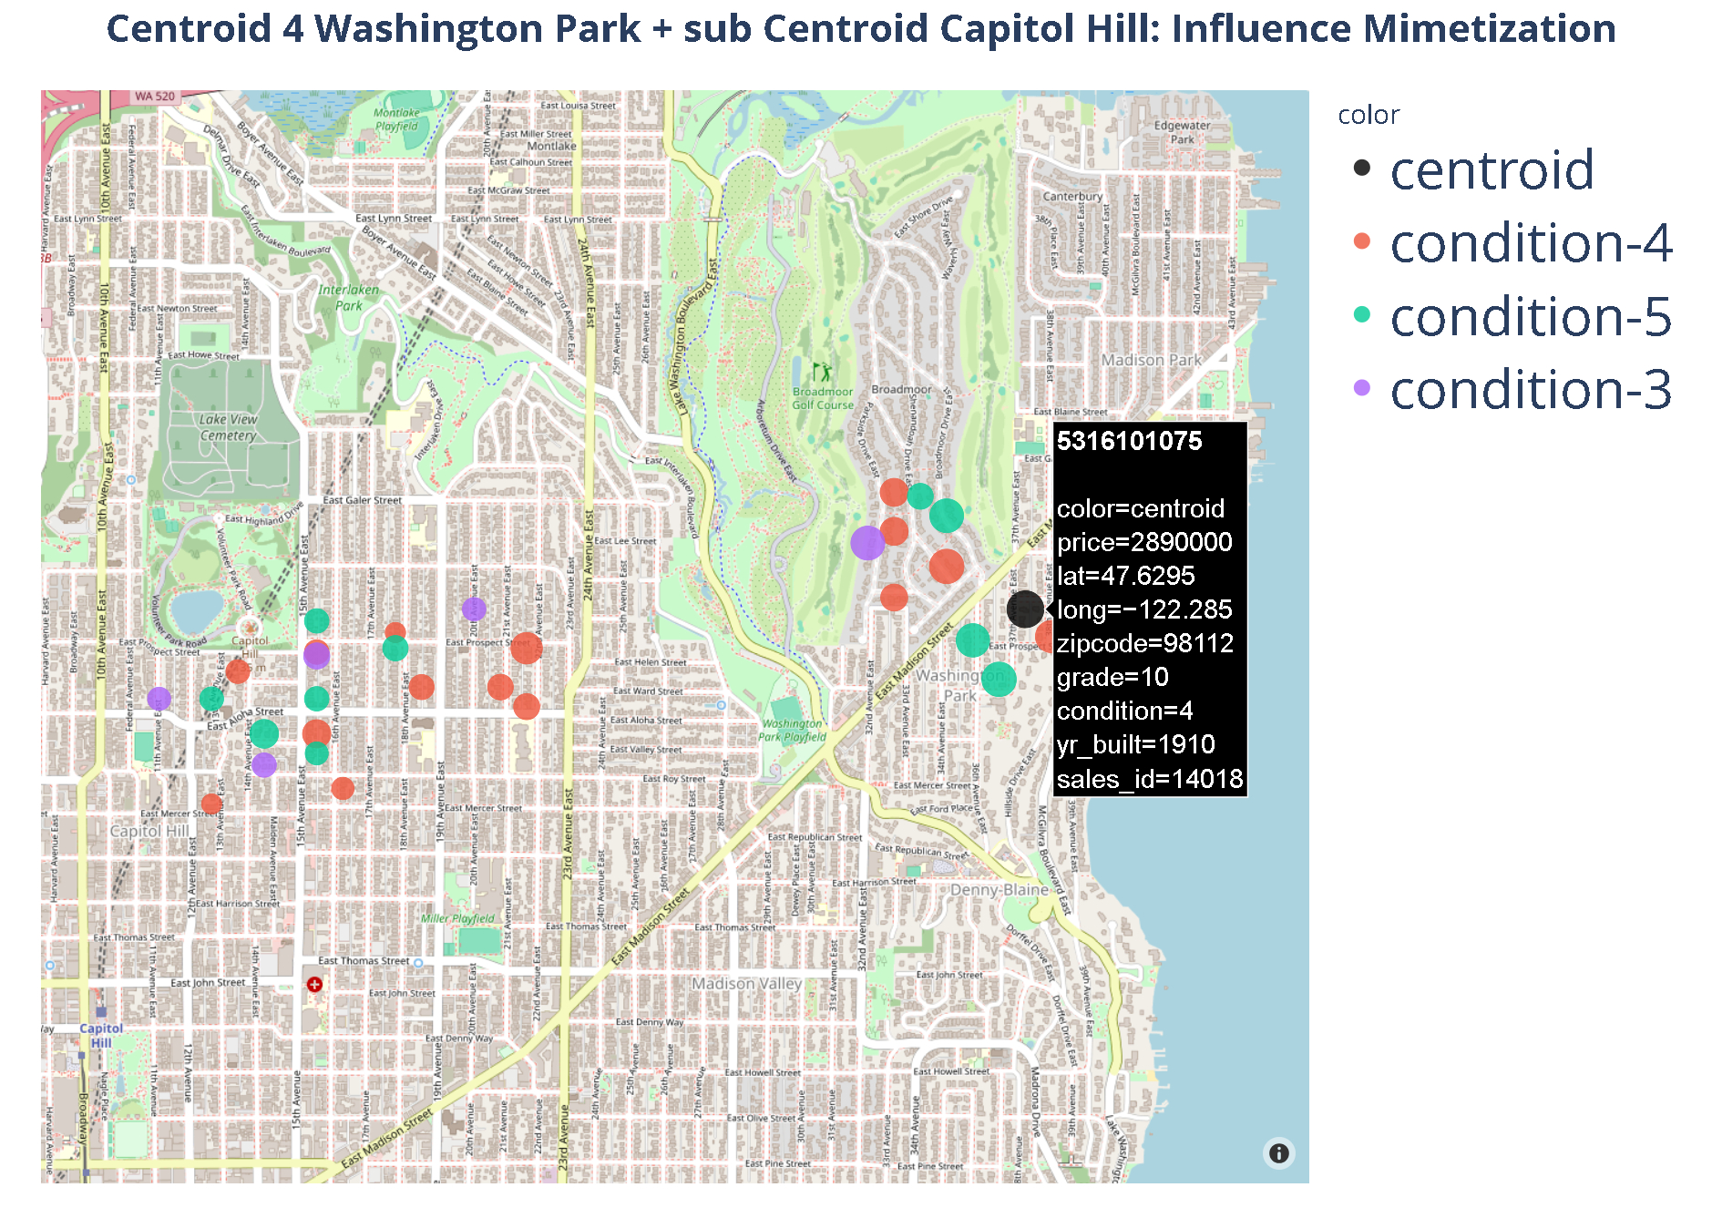

Slide 28
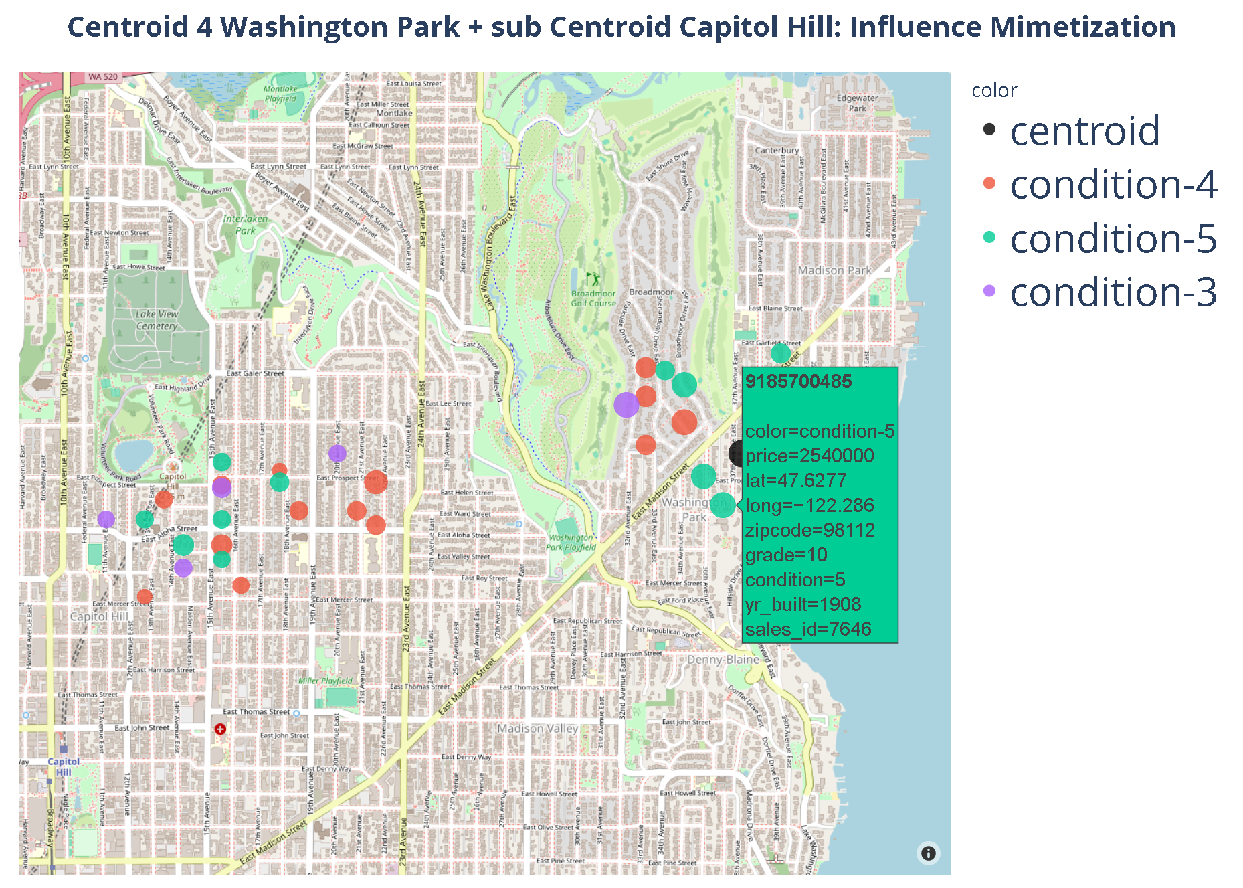

Slide 29
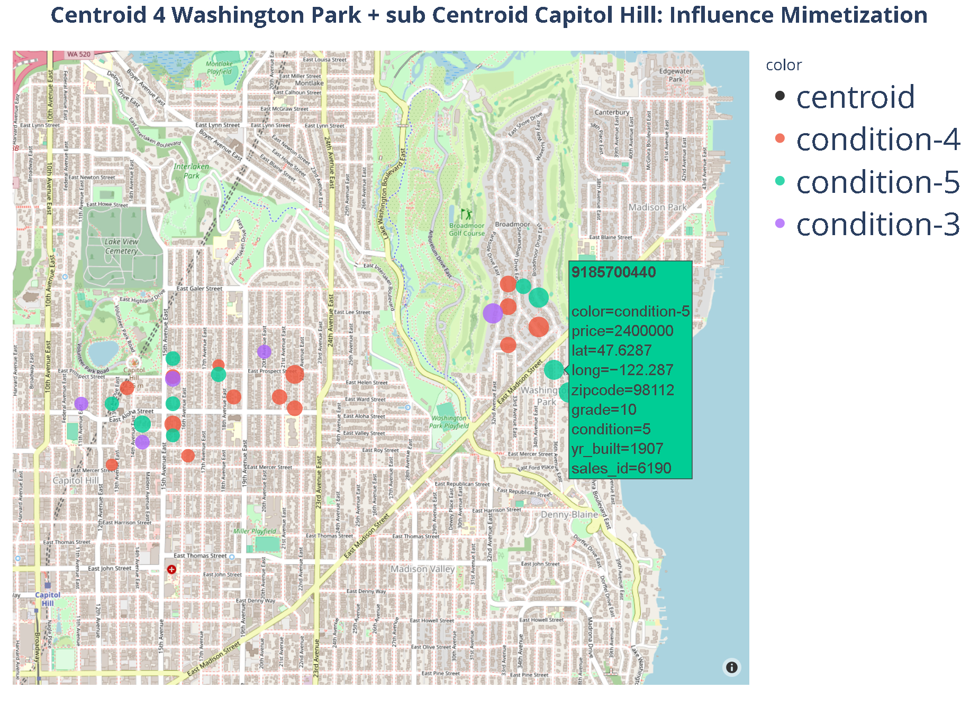

Slide 30
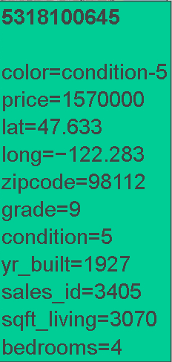
Objective comparison
Bedrooms: 7
Sqft Living:
5350
Price:
2.89M
Bedrooms: 4
Sqft Living:
3070
Price:
1.57 M
Better codition!

Slide 31
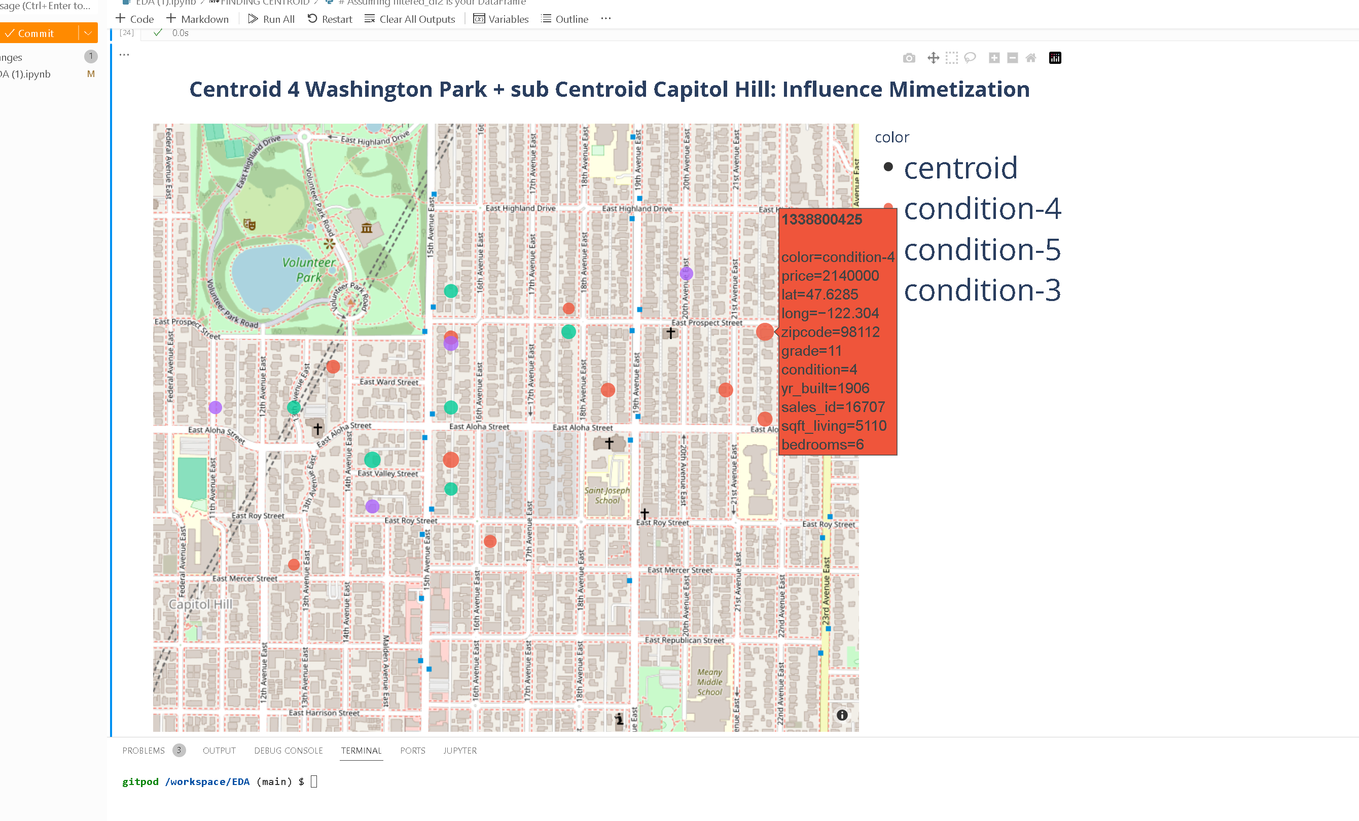
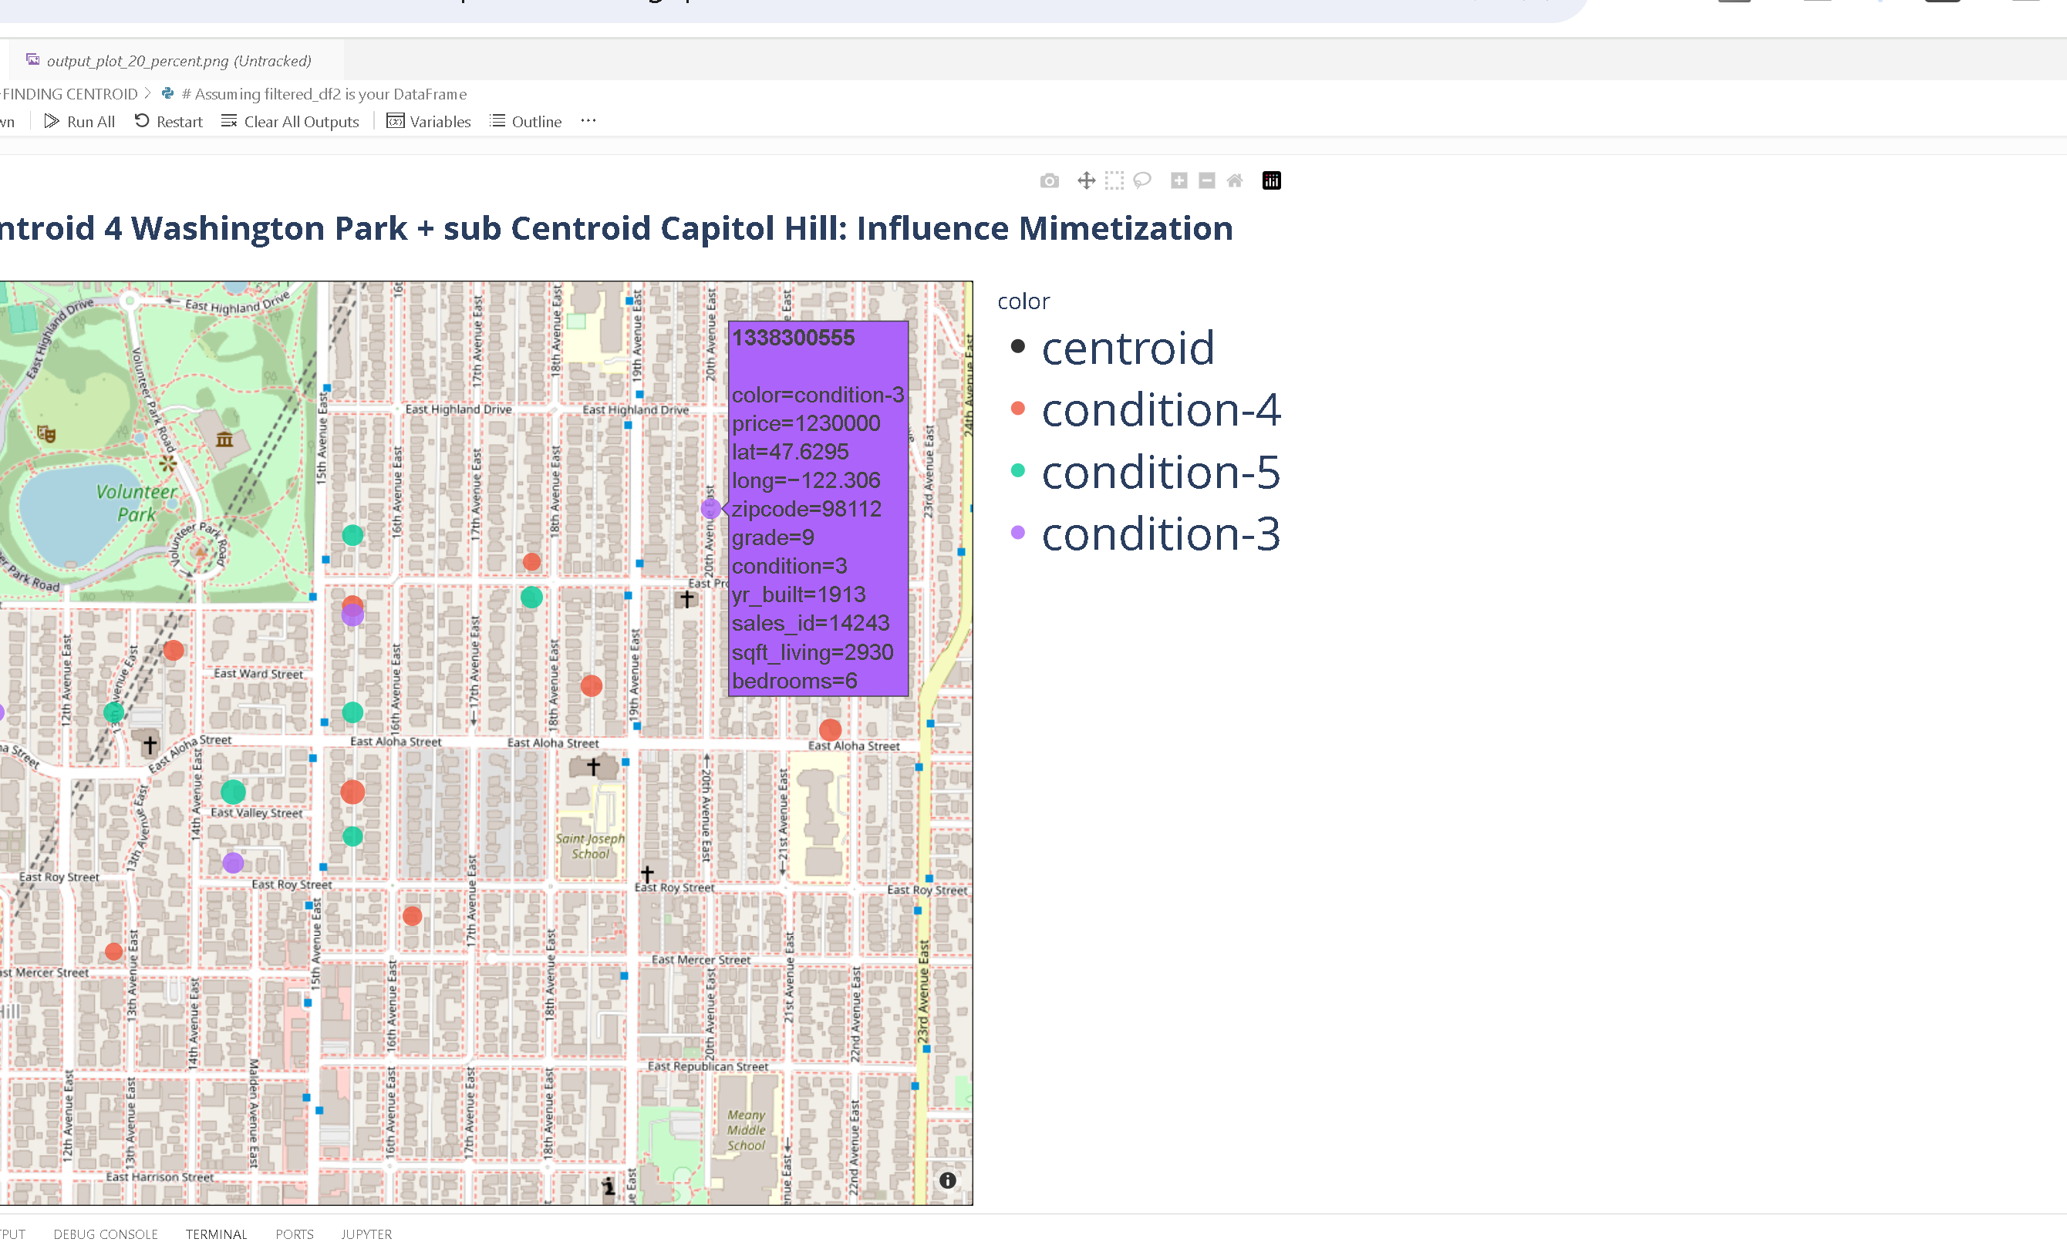
Objective comparison
Bedrooms: 6
Sqft Living:
5110
Price:
2.14 M
Bedrooms: 6
Sqft Living:
2930
Price:
1.23 M

Slide 32
Conclusion.
In Seattle there are several very good investment opportunities, as shown in the districts of Magnolia and
Washington Park , of houses a few blocks close to luxurious houses but for half of the price.
2. Given that condition is normally similar and in some cases even higher, better than renovating is to
use the map of opportunities and buy and sell houses benefiting from status of centroids.

Slide 33
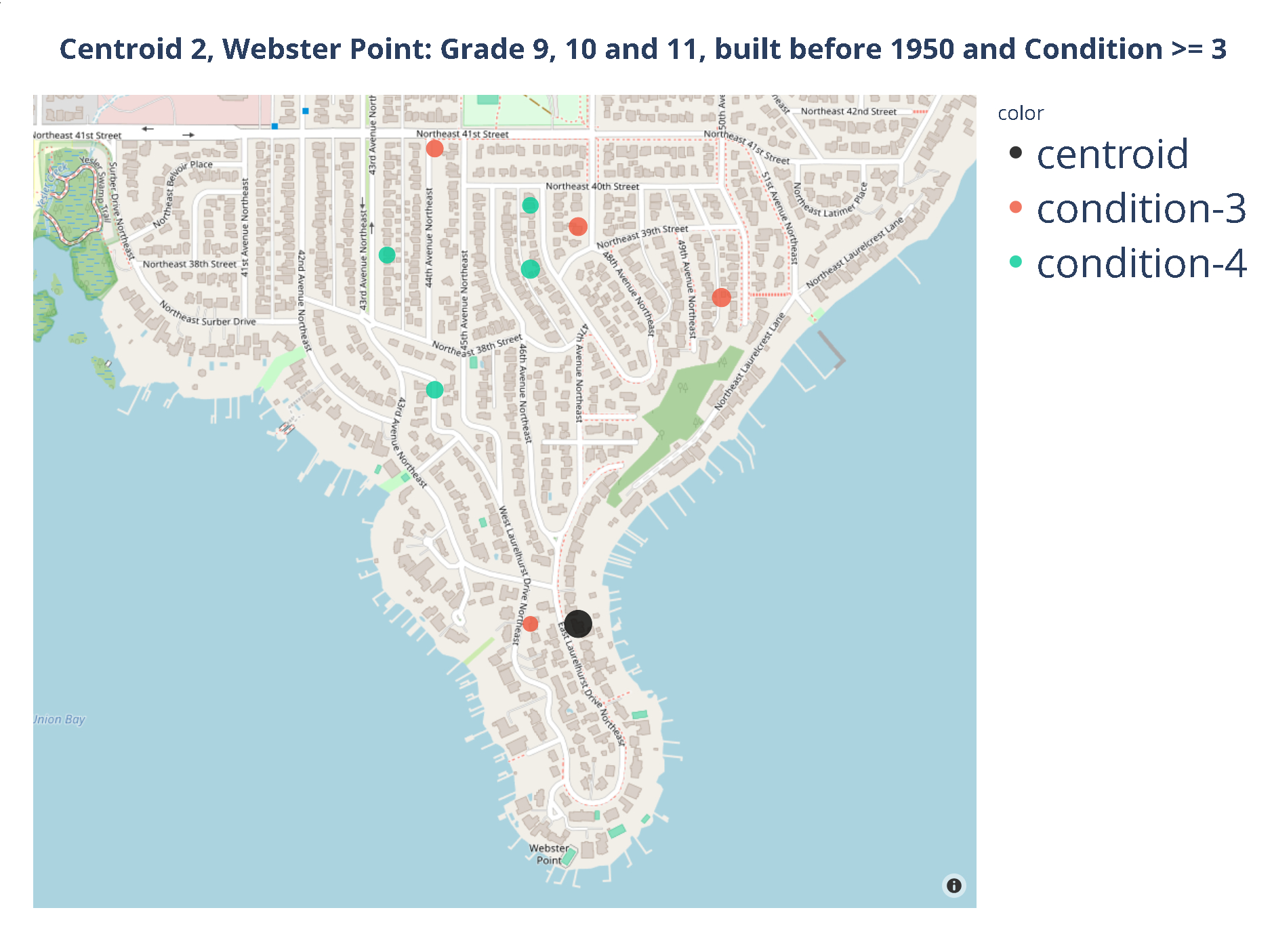

Slide 34
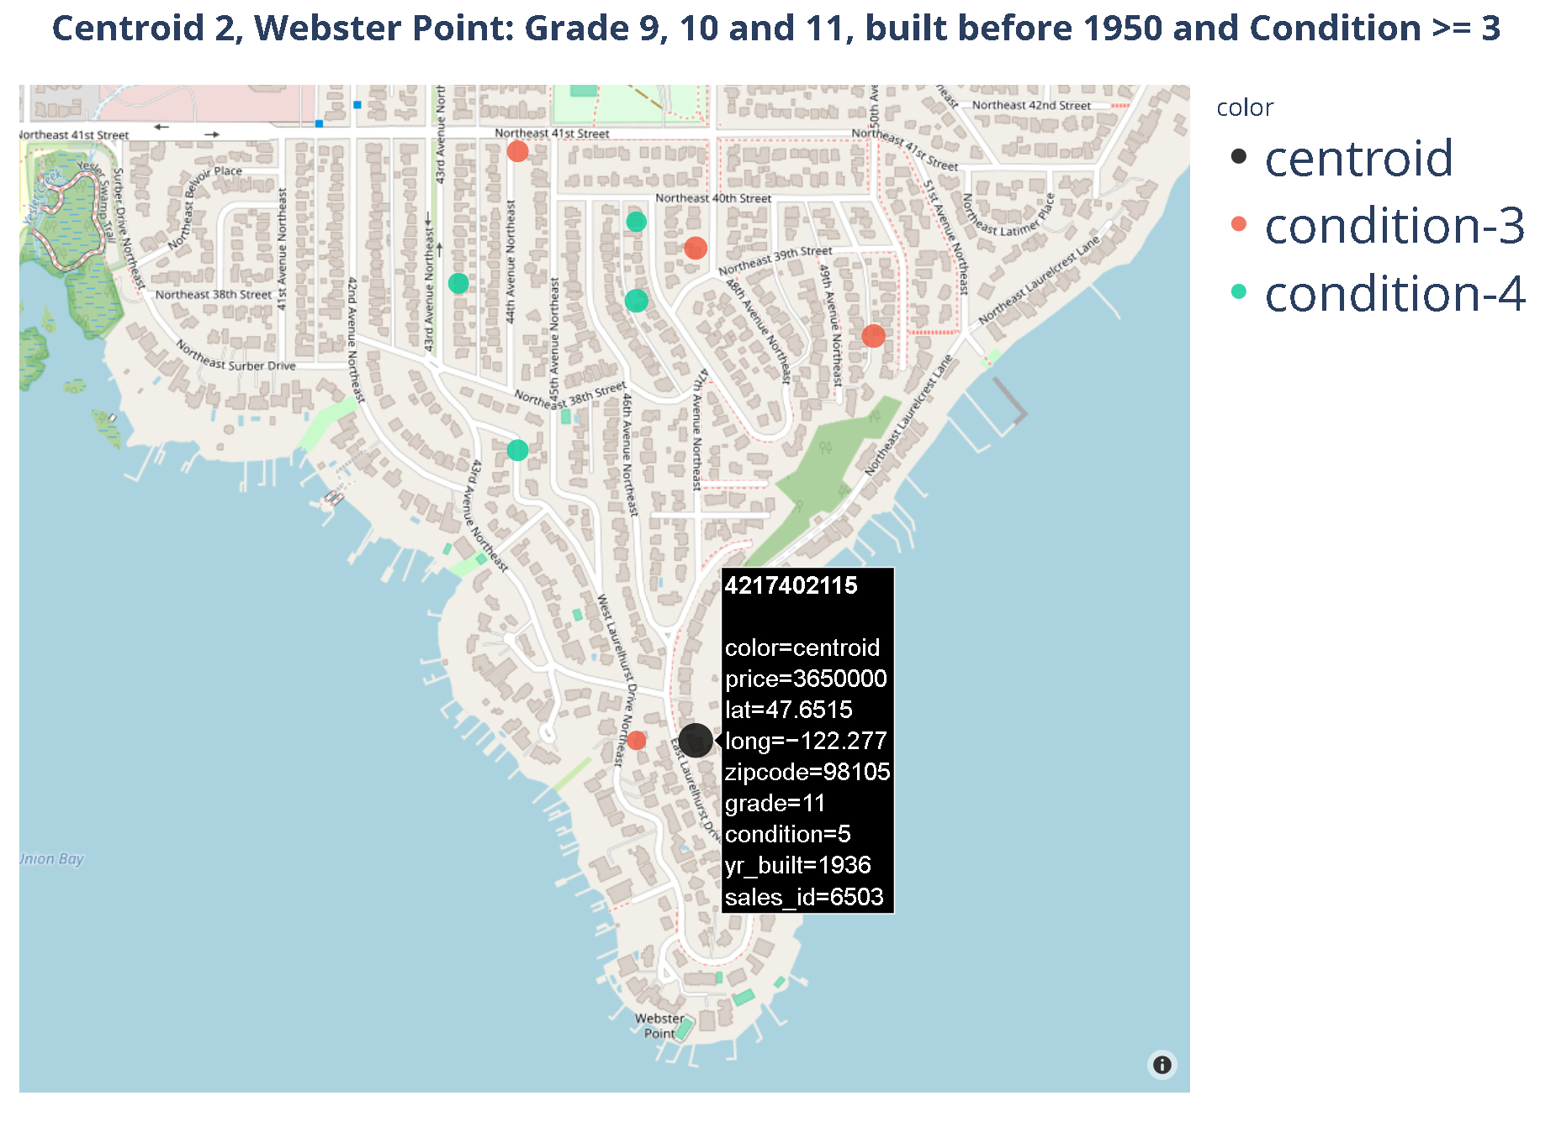

Slide 35
